Slide 1
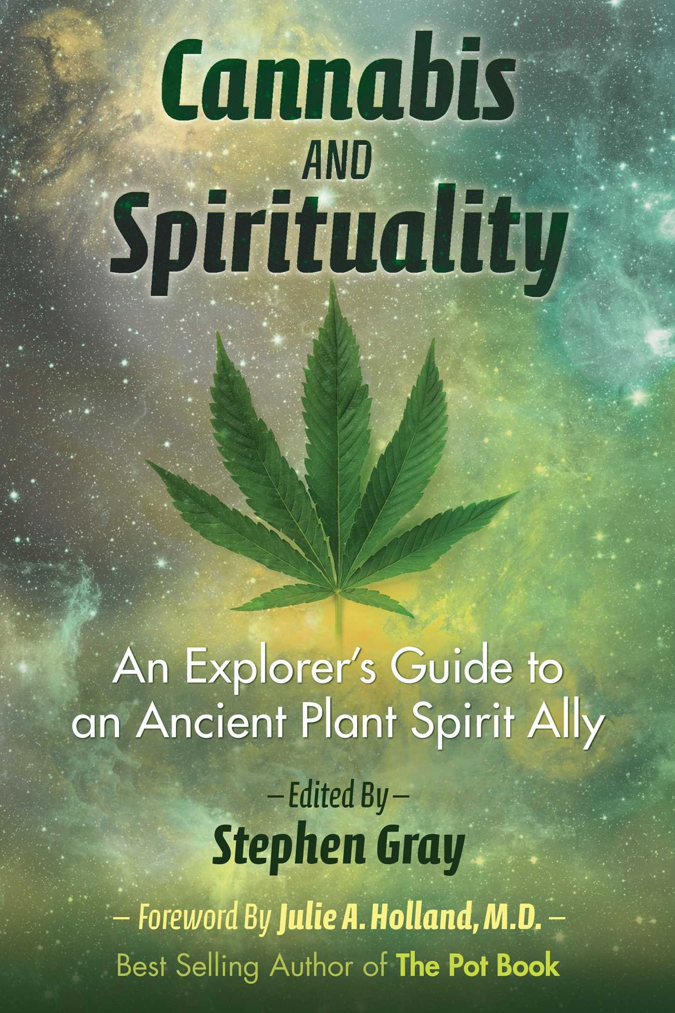
EntheogenS Religious (Sacramental or Spiritual) Psychedelics, thousands of plant species can induce psychotropic effects. Because of cannabis legalization, various psychotropic substances used by indigenous tribes making a comeback.

Slide 2
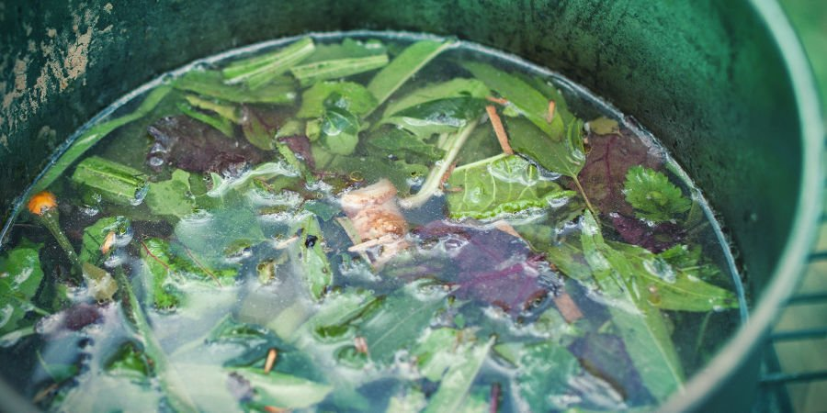
Ayahuasca
Psychoactive component, DMT, Dimethyltryptamine, the “Spirit Molecule,” is the most potent psychedelic known to humans.
Present in dozens of plants. Humans produce it naturally.
Northern South American countries like Peru, Bolivia, and Colombia.
Members of the Urarina, Shuar, Shipibo, and Tukano groups use Ayahuasca for shamanic purposes.

Slide 3
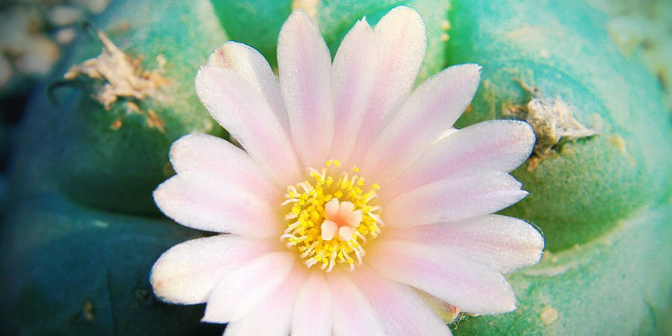
Peyote (Lophophora williamsii)
Short and round cactus.
Mescaline - psychoactive compound
Earliest records of peyote use date back to 3780–3660 BCE, after the peyote cactus was identified in ancient Native American tombs.
Widely used by Huichol natives, tribe existed for thousands of years.
Presently, Peyote is now classified as a “vulnerable” species, and it is used as an entheogen by Native Americans for shamanic purposes.

Slide 4
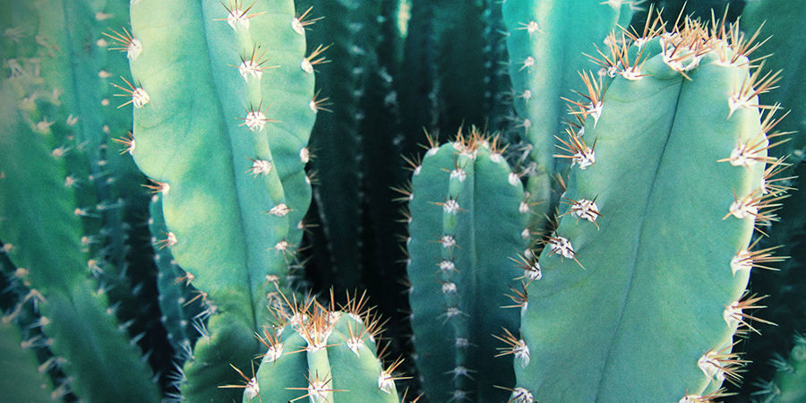
San Pedro cactus
(Trichocereus pachanoi)
Entheogenic cactus, grows in the Andes Mountains of South America.
Earliest records of its use are depicted in a carving made by the Chavín culture, approximately 1400–400 BCE, displaying a figure holding the San Pedro cactus.
Contains several alkaloids, including mescaline and 5-dimethoxyphenethylamine, psychoactive substances, induce transcendental entheogenic experiences.

Slide 5
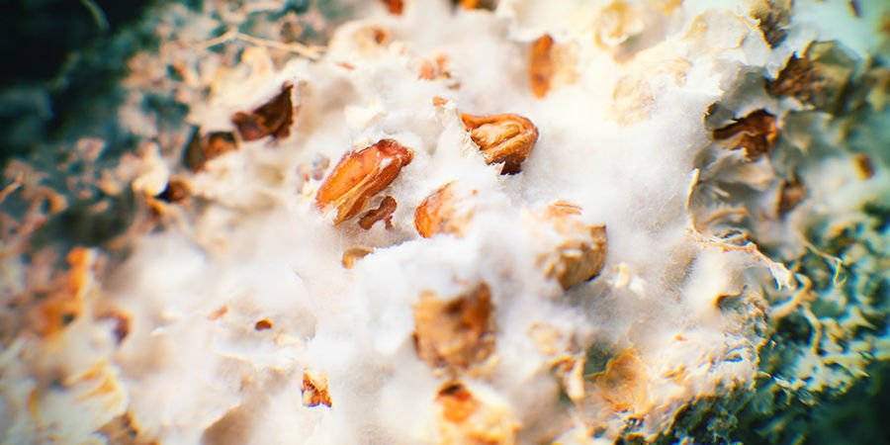
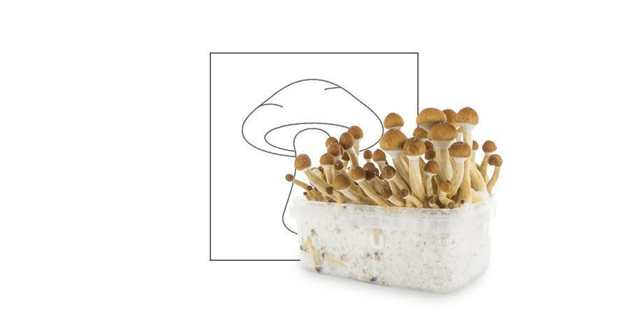
Psilocybe mushrooms
“magic mushrooms” or simply “shrooms”, very common entheogen.
Psychoactive compounds: psilocybin and psilocin.
Used by aboriginal Mexicans who referred to them as “teonanácatl” - “divine mushroom”.
Hallucinations, spiritual experiences, and euphoria are commonly noted effects of magic mushrooms.

Slide 6
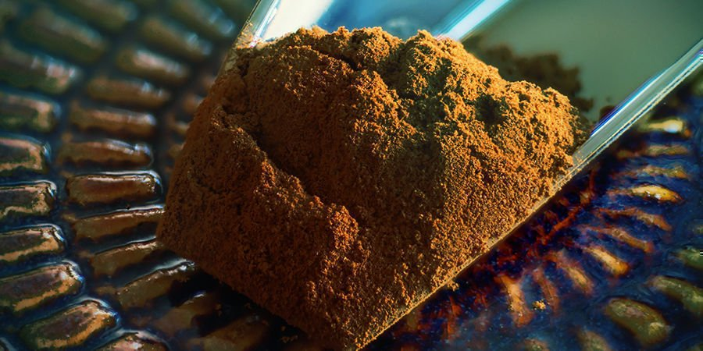
Iboga (Tabernanthe iboga)
Shrub - grows in Gabon and Cameroon.
Used to combat fatigue, hunger, and thirst, and as an entheogenic to connect with spiritual ancestors.
Ibogaine is the main psychoactive compound produced by the plant.
It brings up early memories, which help to review and reassess one’s life.
It can also induce a dream-like state and visual hallucinations.
The Bwiti religion uses Iboga for sacramental purposes.

Slide 7
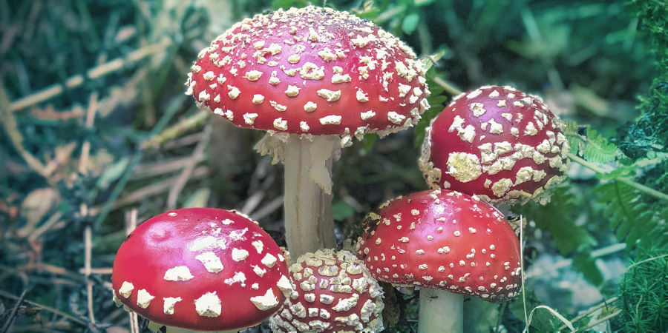
Fly agaric (Amanita muscaria)
Entheogenic mushroom
Easily confused with lethally poisonous mushrooms.
Fly agaric contains ibotenic acid, which is then converted to muscimol to produce psychoactive effects. It does not taste good.
Generates sedative, dreamy, and trippy effects, either "heavenly" or extremely frightening effects.
When mistaken with a poisonous mushroom, the consequences can be grave.

Slide 8
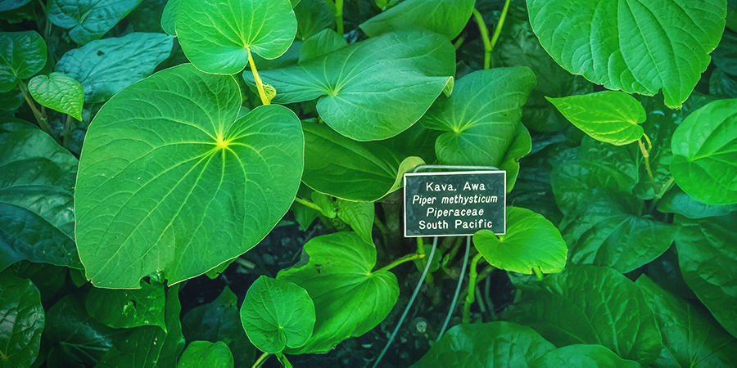
Kava
(Piper methysticum)
or "kava-kava" or "yaqona“
Member of the pepper family.
Social/ceremonial drink from the roots of the kava shrub.
South Pacific Island and Polynesian Islands for its tranquil and euphoric effects.
Kavalactones and kavapyrones being its active constituents.
Produces anxiolytic and psychoactive effects experienced at higher doses.
Smaller doses induce relaxing sensations.

Slide 9
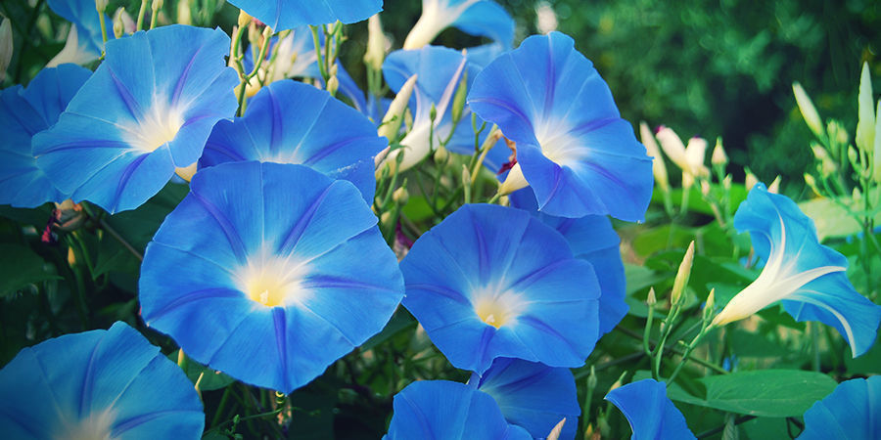
Morning glory
(Ipomoea tricolor)
Entheogenic plant, nicknamed “Heavenly Blue”.
Its seeds are used for entheogenic purposes.
Used by Mexican Native Americans dating back to the Aztecs to explore other planes of consciousness.
Ergine is the psychoactive substance, plus other alkaloids like lysergic acid hydroxyethylamide and ergonovine are also produced by the plant.

Slide 10
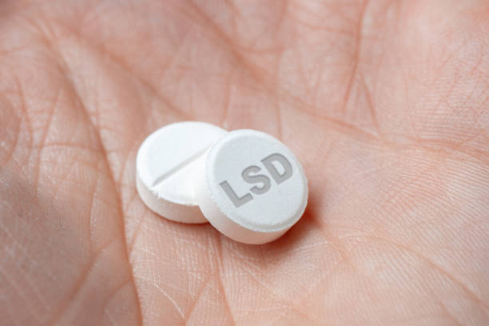
LSD (lysergic acid diethylamide)
Synthetic entheogen
Entheogen is very potent, mind-bending, interesting hallucinations, profound spiritual wisdom and euphoria under the influence.
Developed by Albert Hofmann in Basel, Switzerland as part of a research program.
After accidentally ingested it, he experience entheogenic powers of LSD.
Woodstock festival in 1969 - LSD hotspot.

Slide 11
Cannabinoids & cannabimimeticS (or Cannabinoid-like)
Are defined as molecules (or compounds) that interact with the receptors of the endocannabinoid system (ECS).
Endo-cannabinoids
Human/Animals
Plant or Phyto- Cannabinoids
Terpenes & Flavonoids
Ubiquitous

Slide 12
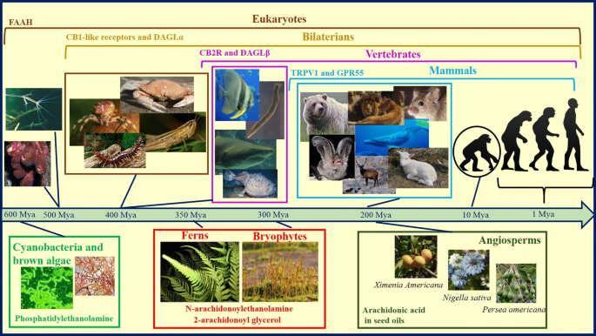
Cannabinoid and Cannabimimetic Plants
2-AG
Anandamide – “Bliss” (Like THC); 2-AG is like CBD

Slide 13
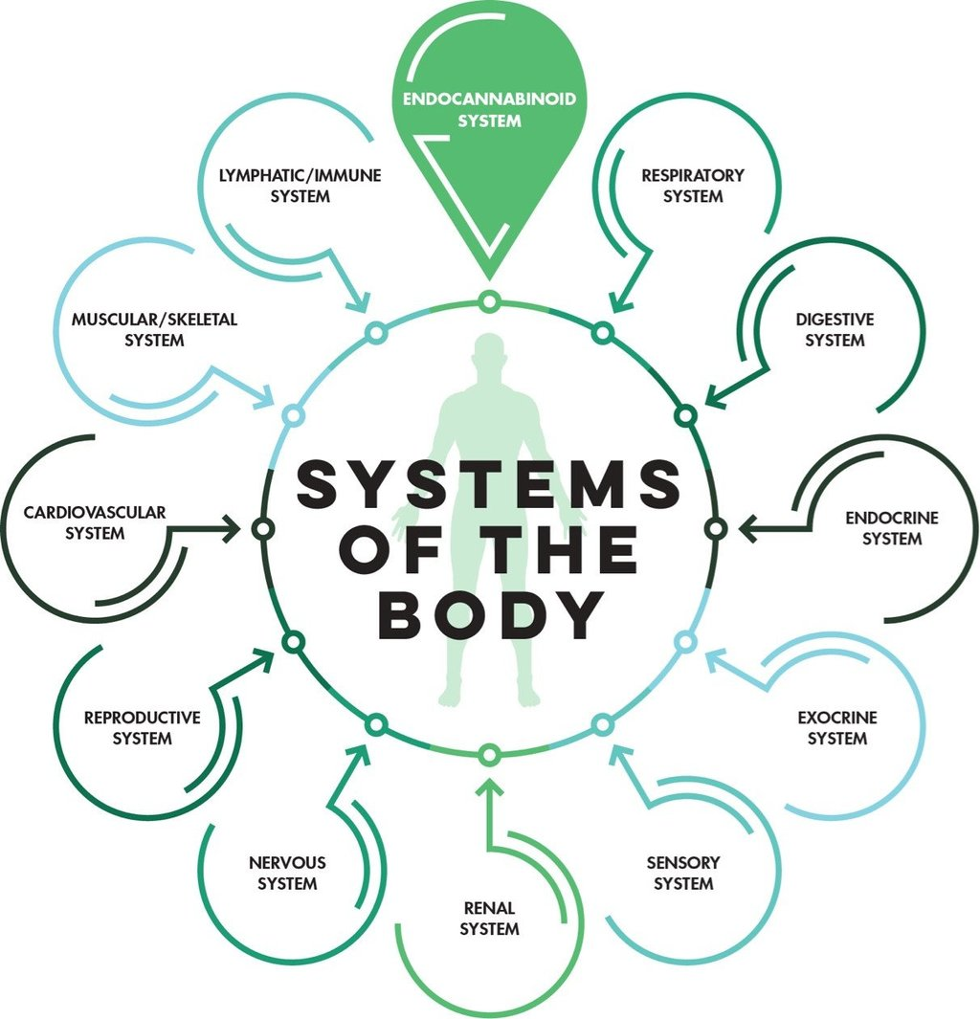
EndoCannabinoid
System
(ECS)

Slide 14
Endocannabinoid System (ECS)
Traffic Cops
1. Endocannabinoids (eCBs)
lipid-based neurotransmitters
Docking Sites
2. Cannabinoid RECEPTORS
(CB-1 and CB-2 receptore)
3. Enzymes that synthesize and break down eCBs

Slide 15
Human Endocannabinoids
ENDO means Internal, or Within all humans and animals
Integral components of cellular membranes, manufactured on demand. Neurotransmitters (Messengers) – Fatty Acids (Lipids)
AEA (Anandamide) – (like THC) – discovered in 1992
2-AG (2-Arachidononoyl-Glycerol) – (like CBD)
N-arachidonoyl dopamine (NADA), and Virodhamine (OAE)
EndoCannabinoid System (ECS)
Endocannabinoids, and
Enzymes

Slide 16
AEA
arachidonyl ethanolamine
Like CBD
Human
Endocannabinoids
2-AG
Like THC

Slide 17
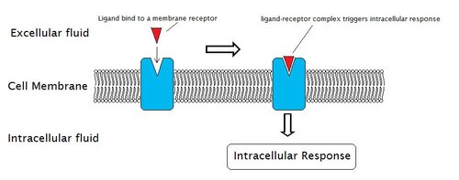
Endocannabinoid System
Cannabinoid
Agonist - Stimulate
Antagonist - Inhibits

Slide 18
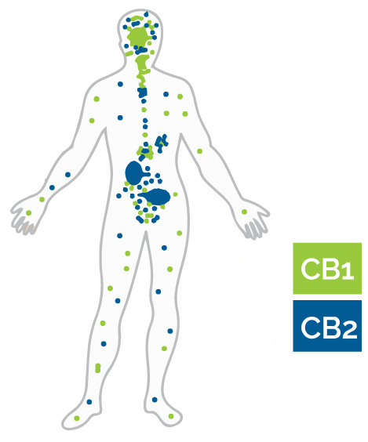
Distribution of Endo-Cannabinoid Receptors

Slide 19
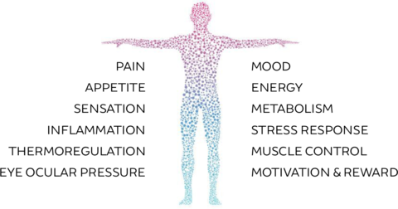
Endocannabinoid
System

Slide 20
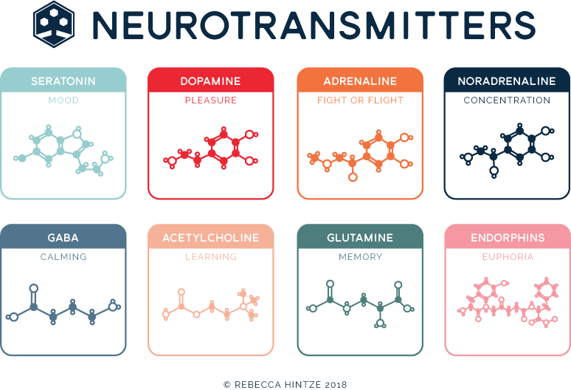
MOOD
PLEASURE
FIGHT OR FLIGHT
CONCENTRATION
CALMING
LEARNING
MEMORY
EUPHORIA

Slide 21
Amino acids: glutamate Type I (excitatory); Type II synapses inhibitory - γ-aminobutyric acid (GABA); glycine
Peptides (>50): oxytocin, somatostatin, opioid peptides;
Acetylcholine (ACh) ; first known neurotransmitter
Purines: adenosine triphosphate (ATP), adenosine;
Monoamines: dopamine; norepinephrine, epinephrine, histamine, serotonin;
Catecholamines: dopamine, norepinephrine, epinephrine;
Trace amines: phenethylamine, tyramine, tryptamine;
Gasotransmitters: nitric oxide (NO), carbon monoxide (CO), hydrogen sulfide (H₂S)
Lipids: Endocannabinoids - Anandamide and 2-AG
Chemical
Neurotransmitters

Slide 22
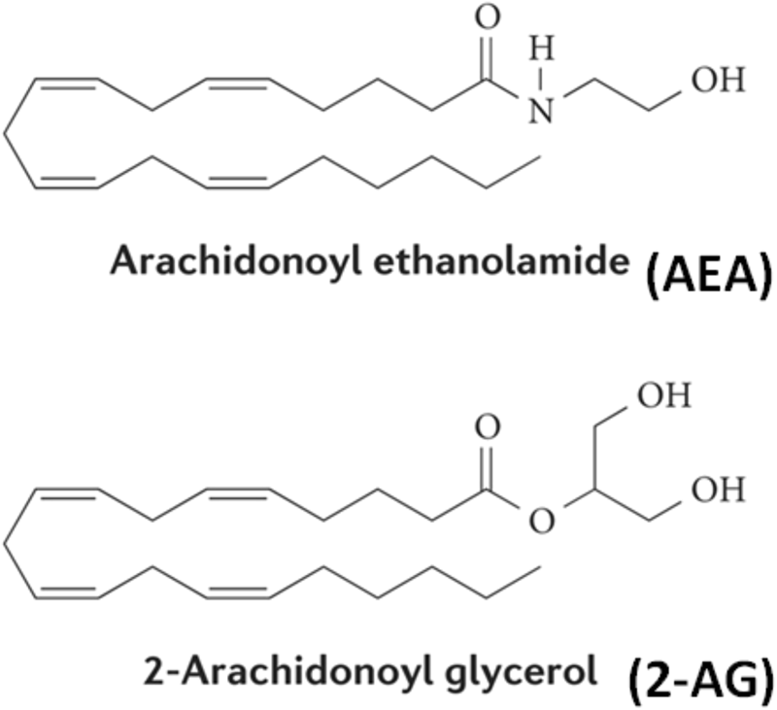
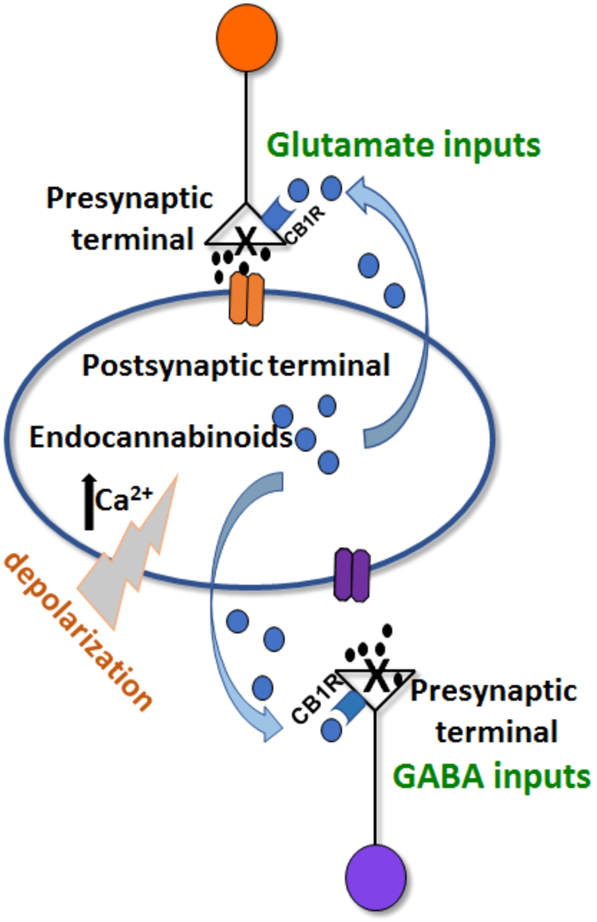

Slide 23
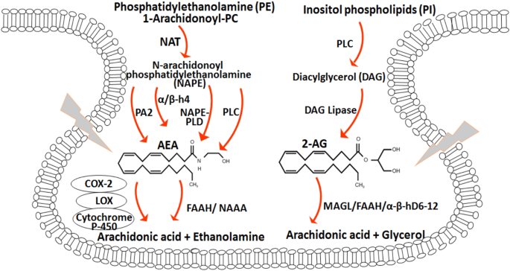

Slide 24
Anandamide with CBD or THC
CBD (Cannabidiol) moderately inhibits the degradation of anandamide.
This would result in retaining higher anandamide levels.
When experiencing feelings of pain, anandamide binds to the CB1 receptor, and blocks pain signaling.
Cannabinoid and their Metabolites are Inhibitors of Major Hepatic CYP450 Enzymes, including CYP2B6, CYP2C9, and CYP2D6, with Implications for Cannabis-Drug Interactions.
THC competitively inhibited CYP1A2, CYP2B6, CYP2C9, and CYP2D6; CBD competitively inhibited CYP3A4, CYP2B6, CYP2C9, CYP2D6, and CYP2E1; and CBN competitively inhibited CYP2B6, CYP2C9, and CYP2E1. THC and CBD showed mixed-type inhibition for CYP2C19 and CYP1A2, respectively.

Slide 25
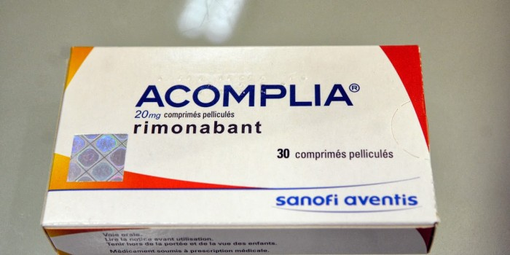
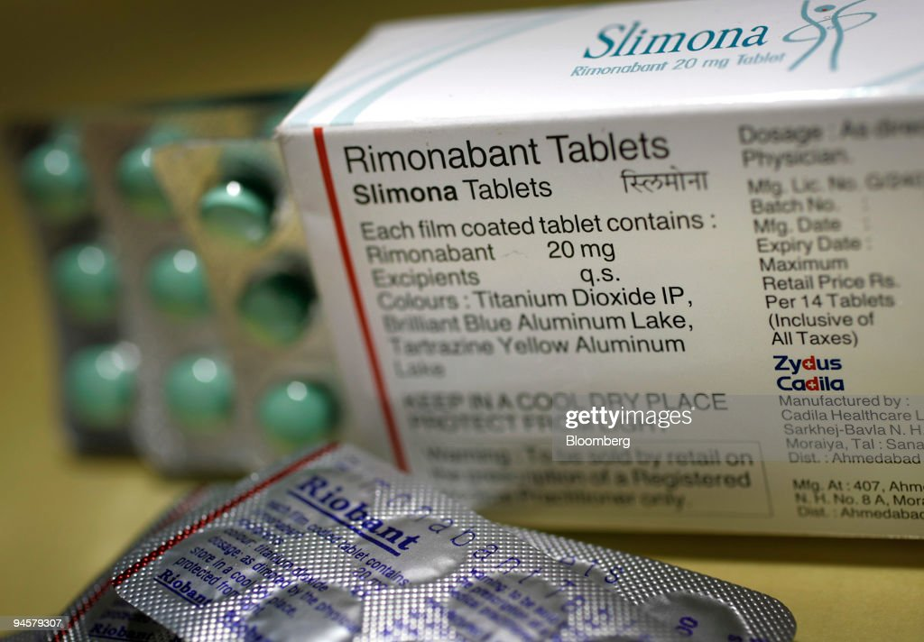
Rimonabant is a potent and selective cannabinoid CB1 receptor antagonist Not approved by FDA to treat Obesity.

Slide 26
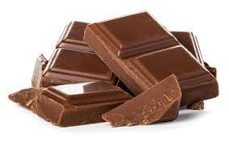
Compounds Found in Chocolate that can Act as a Drug
ANANDAMIDE -- N-arachidonoylethanolamine (AEA)
Chocolate contains small quantities of anandamide, an endogenous cannabinoid (endocannabinoid) found in the brain and nerves.
Anandamide is a neurotransmitter that targets the same brain structures as THC, the active ingredient in cannabis.
Chocolate produce its 'high’ via anandamide itself, and two chemicals known to slow the breakdown of anandamide, the natural stimulant in the brain.

Slide 27
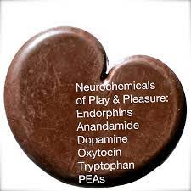
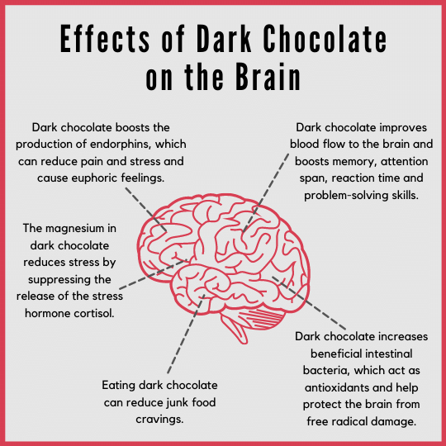

Slide 28
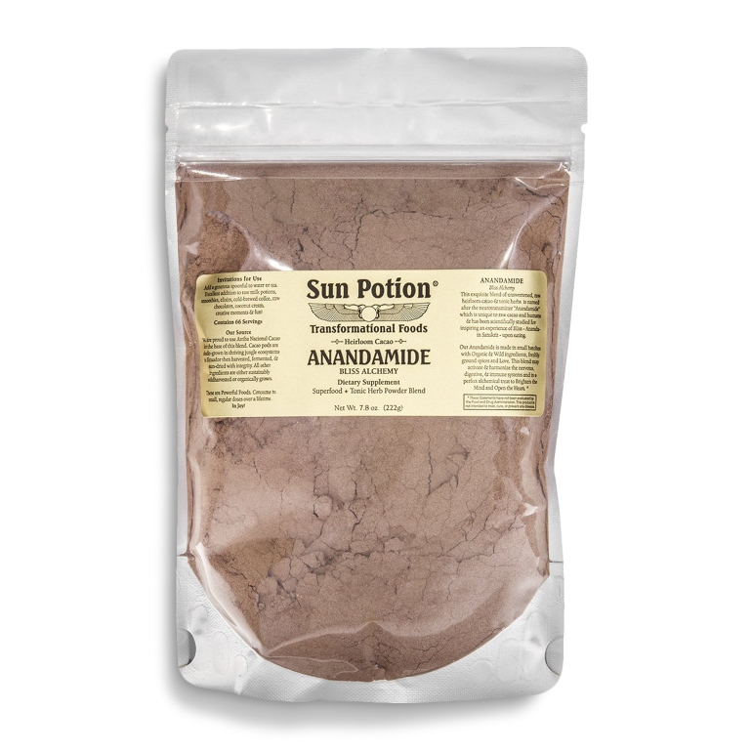
Anandamide
An exquisite blend of Unsweetened and Raw Heirloom Cacao and Tonic Herbs named after the cannabinoid neurotransmitter "Anandamide" which is unique to humans and raw cacao and has been scientifically documented to inspire an experience of a blissful state- Ananda- upon eating.

Slide 29
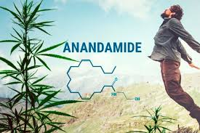
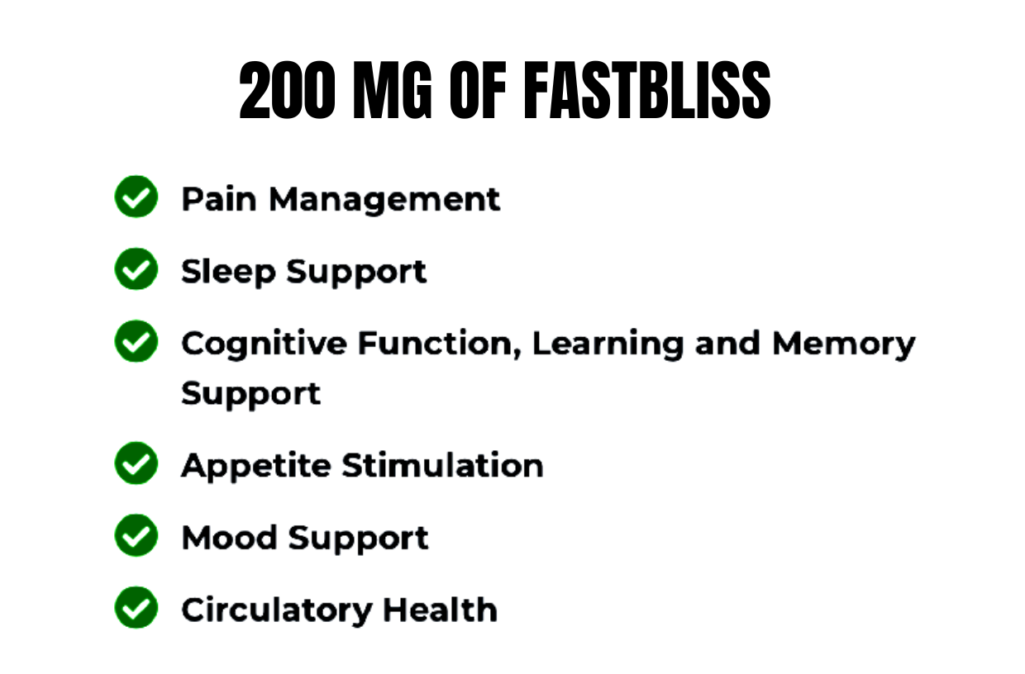
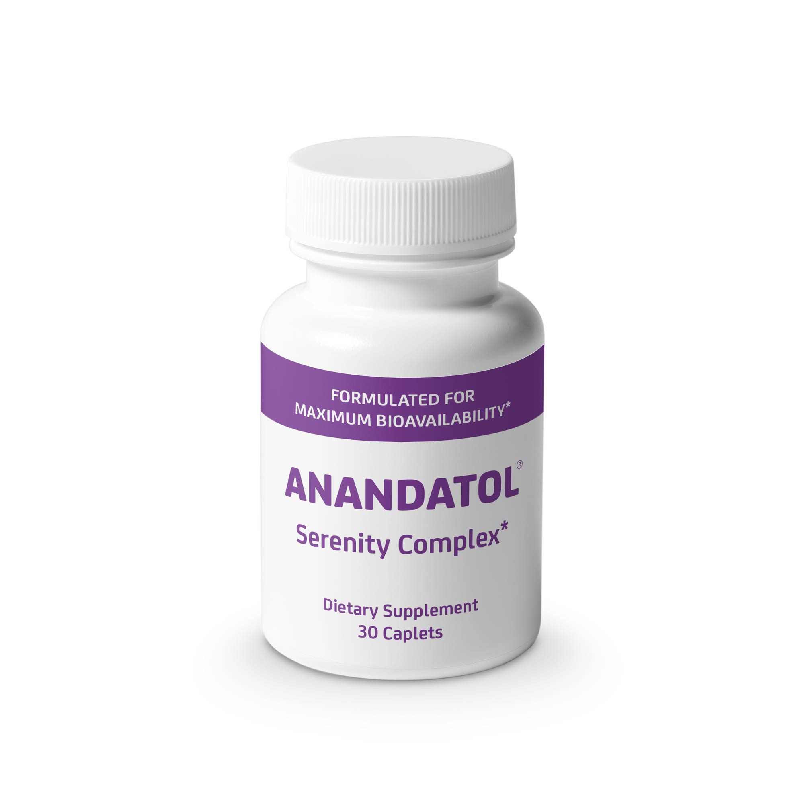

Slide 30
EXERCISE
Click Here to View
2-Minute Video
ENJOY

Slide 31
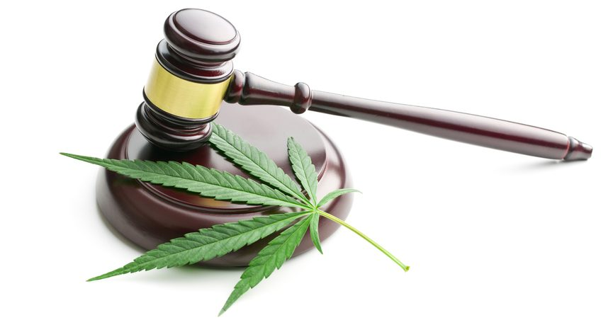
EXOCANNABINOIDS
EXO means external or outside the body.
Neurotransmitters (Messengers)
PHYTOCANNABINOIDS (Produced by Plants) – E.g., THC & CBD and others from Cannabis plant
SYNTHETIC CANNABINOIDS (Produced in Labs)
Endocannabinoids
ENDO means Internal, or Within all humans and animals

Slide 32
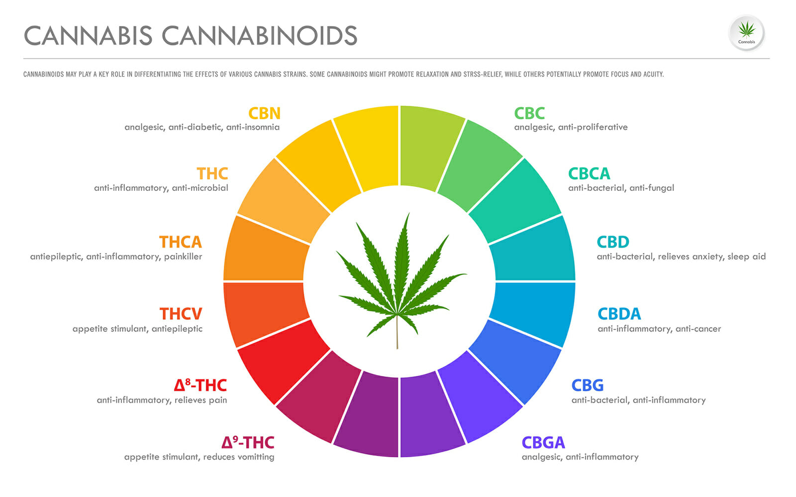
Over 100 Cannabinoids present
About 70 have been isolated

Slide 33
HHC-A
HHC-A (hexahydrocannabonolic acid) is a semi-synthetic cannabinoid and a hydrogenated form of THCA (tetrahydrocannabinolic acid).
Hydrogenation improves compound stability and thermo-oxidative breakdown resistance. In mice test subjects, HHCA reduced tumor size by 39.70%. THCA reduced tumor size by 37.67%.

Slide 34
HHC-O
HHC-O is a very new semi-synthetic cannabinoid. It is an acetylated form of HHC, which is a hydrogenated version of THC. Producers make HHC-O by combining naturally sourced HHC with acetic anhydride and a nickel or platinum catalyst.
This facilitates greater CB1 binding affinity, thus leading to an equally greater euphoric high. It is 1.5 to three times stronger than HHC. Some users mixing HHC-O with CBD to counteract the high and induce more relaxation.

Slide 35
HHC-P
HHC-P - (hexahydrocannabiphorol), an intoxicating semi-synthetic cannabinoid. It is a hydrogenated form of THCP. It is very stable and highly resistant to heat and UV light. It has a long shelf life and little deterioration over long periods.
HHCP products are believed to be up to 30-times more potent than delta-9 THC.

Slide 36
CBN-O acetate
CBN-O, also known as CBN-O acetate, is a rare minor cannabinoid belonging to the cannabinol (CBN) cannabinoid family. Like CBN, CBN-O interacts cannabinoid receptors.
It is stronger than CBN, typically experiencing euphoric, sedative, and stress-relieving effects. It is believed to combat migraines and reduces nausea and anxiety with few after-effects the next morning.

Slide 37
THCP
THCP- (tetrahydrocannabiphorol acetate) is a semi-synthetic cannabinoid and the acetated form of THCP. THCPO is powerfully intoxicating and psychoactive, and users can experience a euphoric high that’s considerably more potent than delta-8 and delta-9.
Some users vaporize 5% THCP-O with 34% HHC, 28% delta-8, 24% CBG, and 9% CBD and experienced a euphoric high for almost ten hours.
THCPO products might be good for pain relief and sleep support in more experienced cannabis users (not for beginners).

Slide 38
THCB
THCb (tetrahydocannabutol, Δ9-Tetrahydrocannabutol, tetrahydrocannabinol-C4) is an intoxicating minor cannabinoid and a homologue of delta-9 THC naturally present in cannabis.
THCb has a better binding affinity at CB1 receptors than THC, but almost equal affinity at CB2 receptors. It is believed to be 13-times stronger than delta-9 and over 20-times more potent than delta-8.
THCb is a possible pain reliever and anti-inflammatory.

Slide 39
THCjd
THCjd (tetrahydrocannabioctyl) is a rare octyl cannabinoid and THC isomer naturally present in cannabis. It is believed to be about 19-times more potent than delta-9.
It binds better at CB1 leading to a more intense and noticeable high.
Mild THCjd doses can promote relaxation and pain relief.
There’s a risk of heightened anxiety and paranoia in higher doses. doses.

Slide 40
THC-H
THC-H (tetrahydrocannabihexol) or Δ9-THCH, is a naturally-occurring cannabinoid and hexyl homolog of delta-9 THC. It was officially discovered in the cannabis plant at the same time as THCP, CBDP, and CBDH in 2019. Scientists invented a synthetic THCH equivalent called parahexyl back in 1949, which was used by doctors as an anti-anxiety treatment in the mid-20th century.

Slide 41
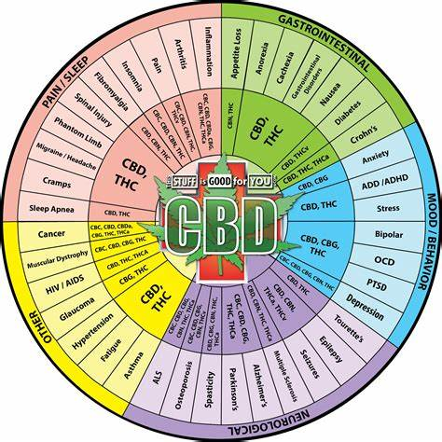

Slide 42
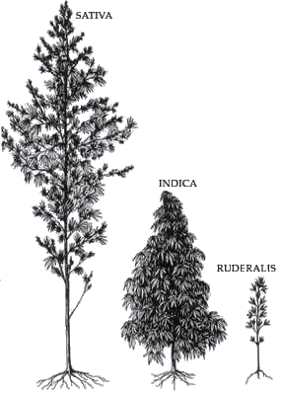
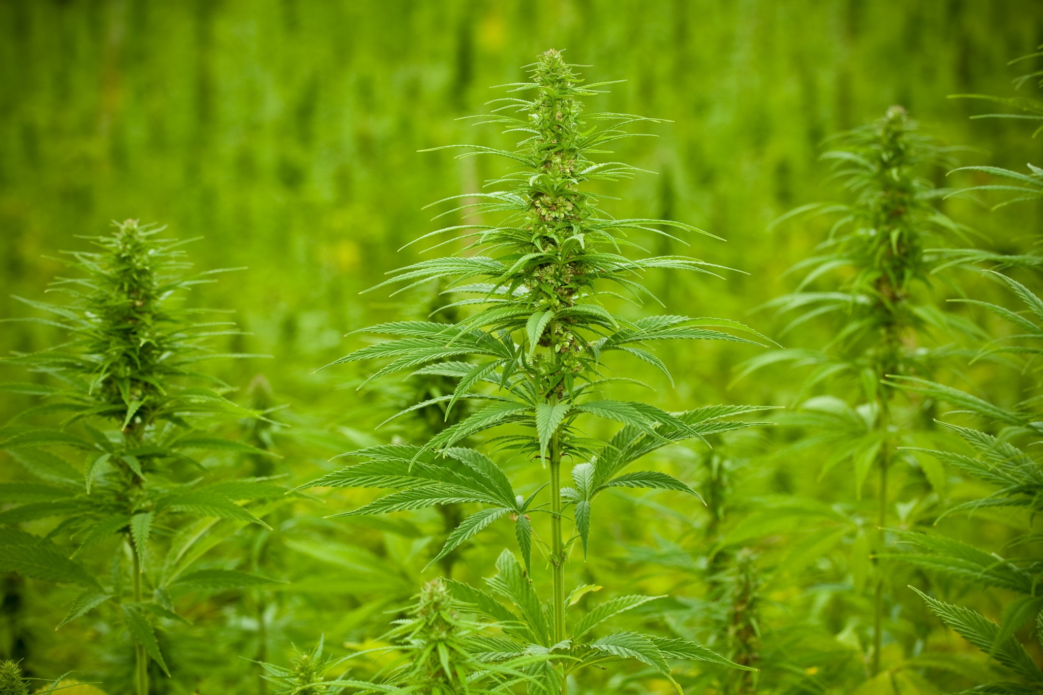
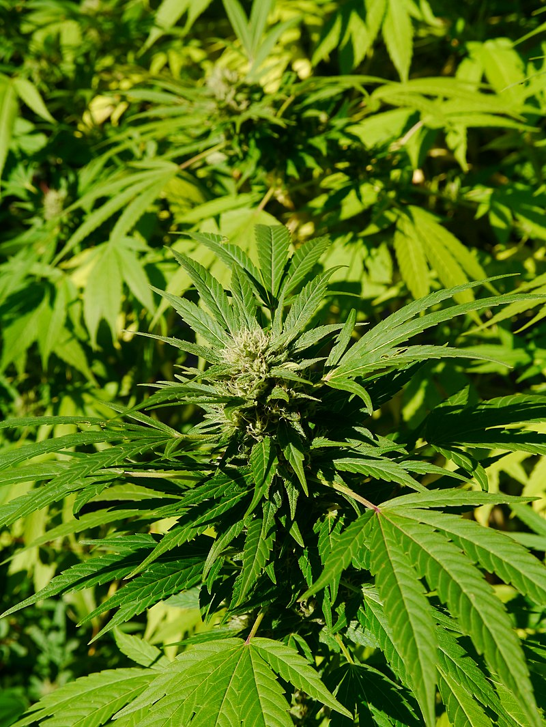
cannabis
Cannabis Sativa

Slide 43
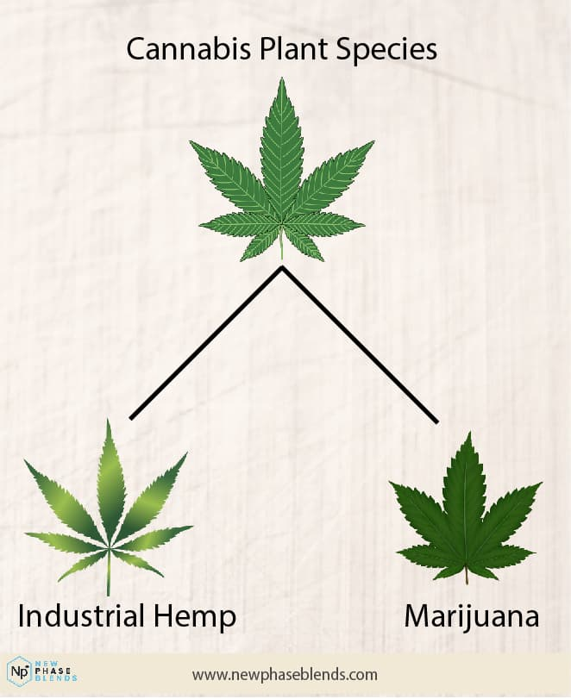

Slide 44
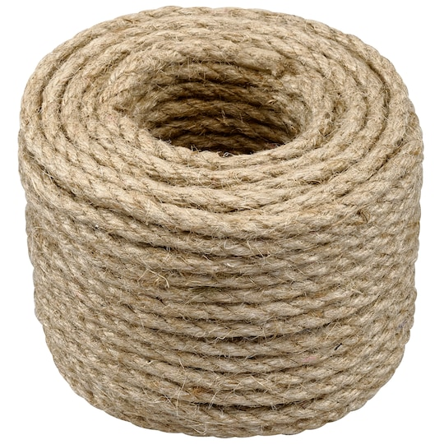
Hemp Rope
Notes:
Hemp rope for many purposes.

Slide 45
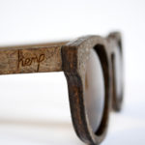
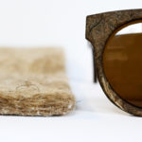
sunglasses and Ski Goggles
Notes:
Frames for sunglasses and goggles.

Slide 46
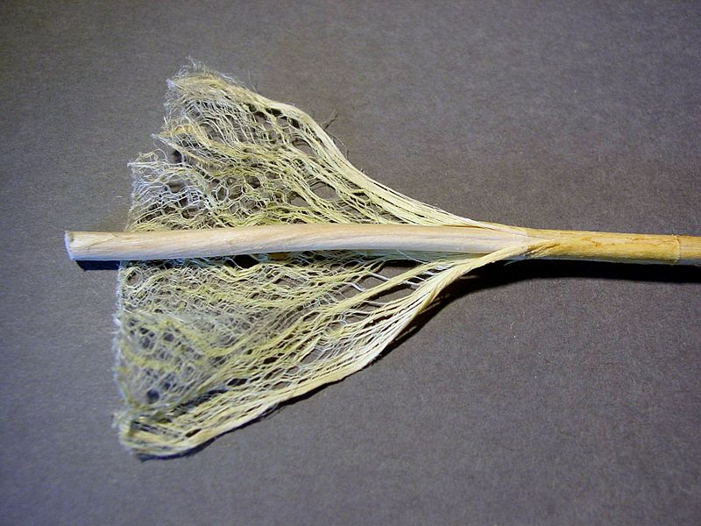
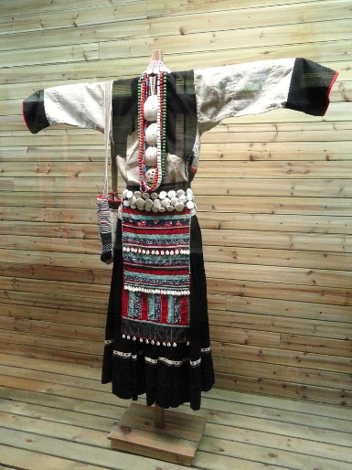
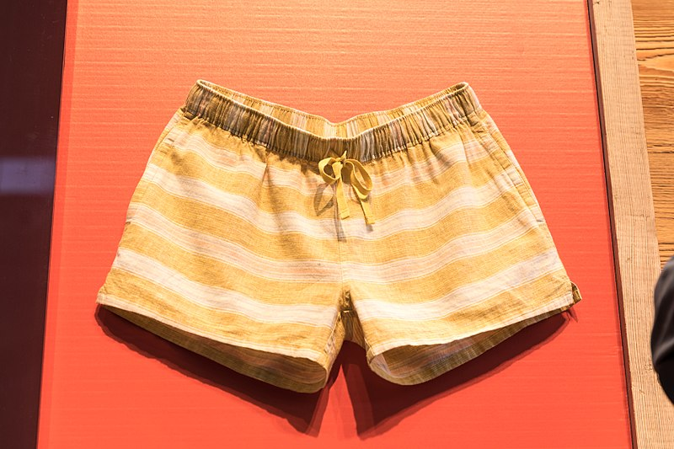
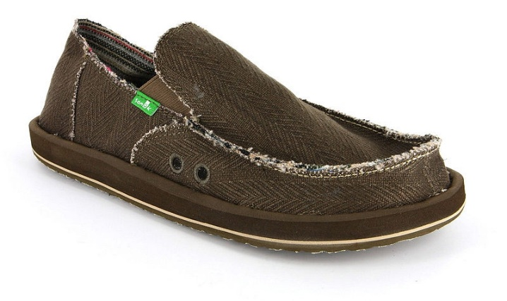
Hemp Paper, Fiber, Clothes, Jewelry
Notes:
Hemp paper, fiber, clothing, shoes and jewelry

Slide 47
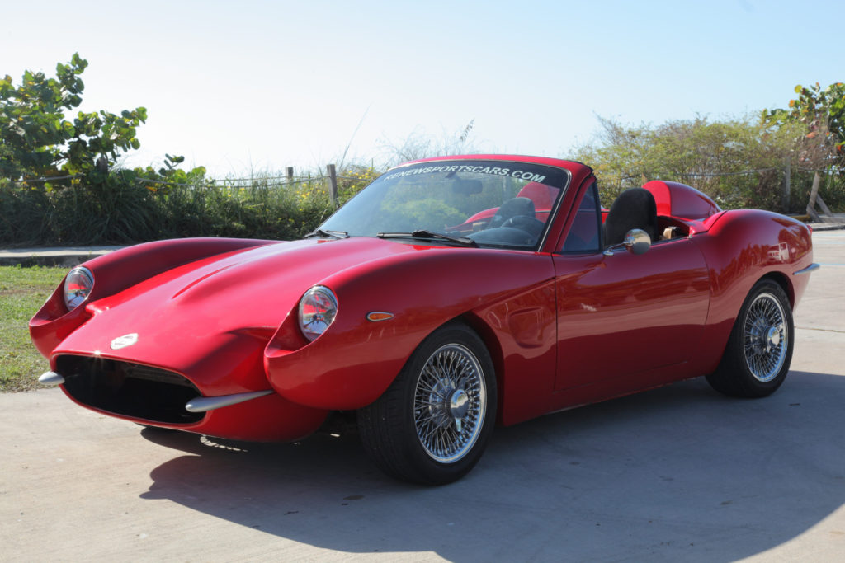
Hemp Composites for Automobiles
Notes:
Hemp composites for cars such as dash boards.

Slide 48
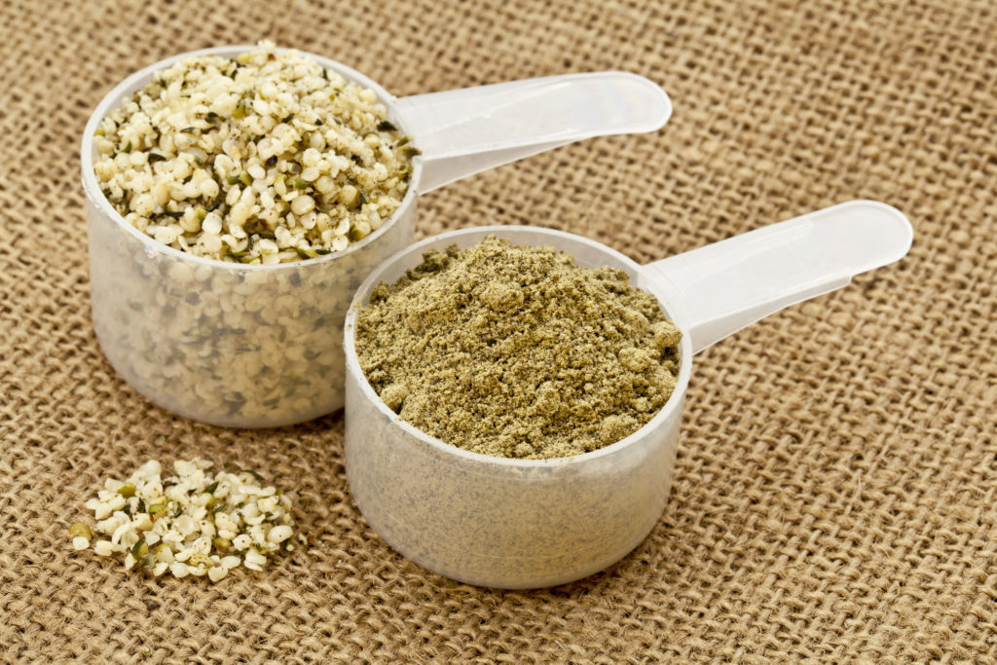
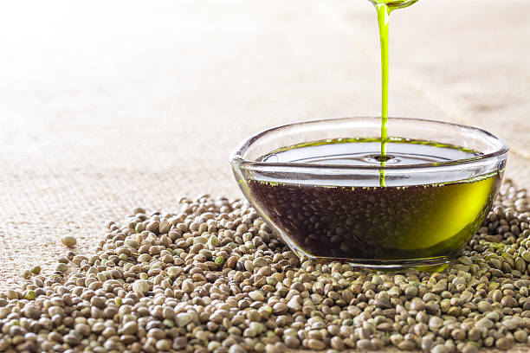
Hemp Food and Oil
Notes:
Hemp nutritious food and oil for cooking

Slide 49
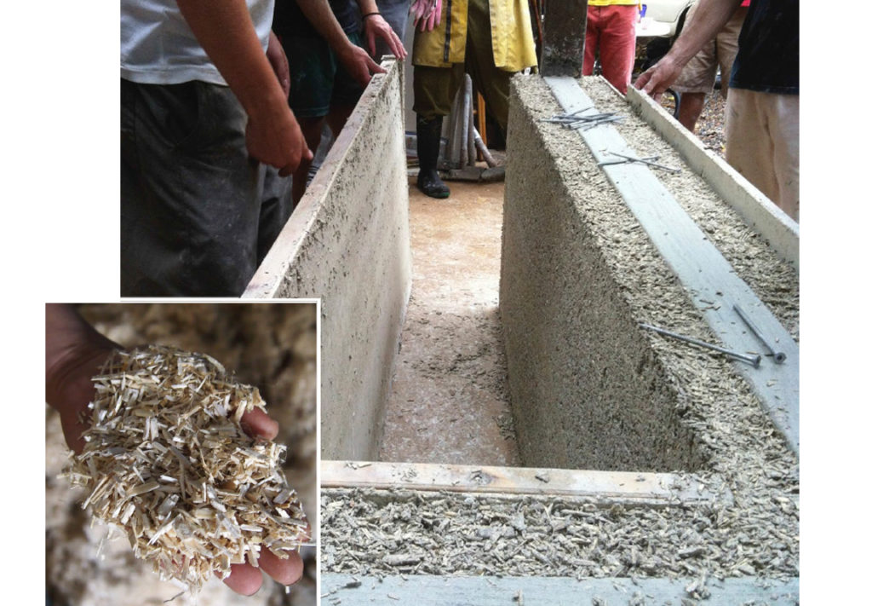
Hemp Building Materials
Notes:
Hemp is used for building materials

Slide 50
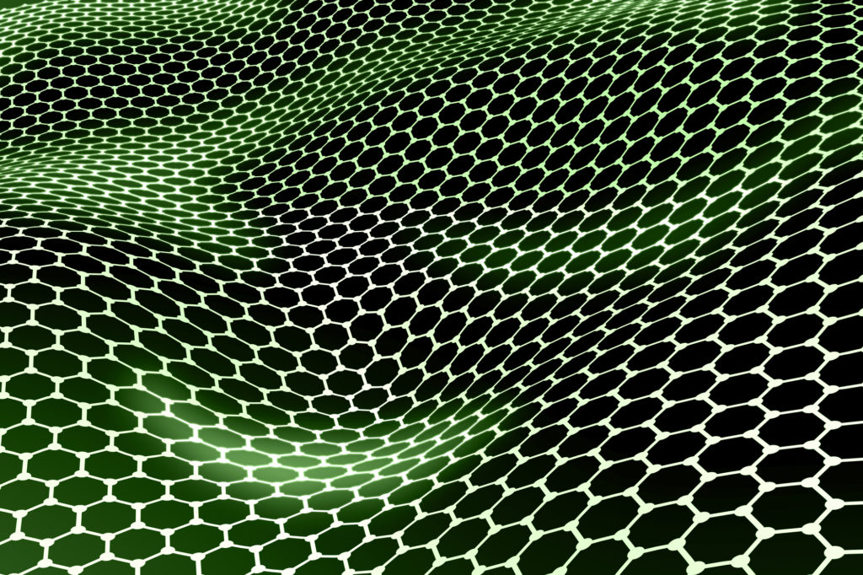
Hemp Nanomaterials: graphene-like nano-sheets used for supercapacitor electrodes
Notes:
It is also used in hemp Nanomaterials such as: graphene-like nano-sheets used for supercapacitor electrodes.

Slide 51
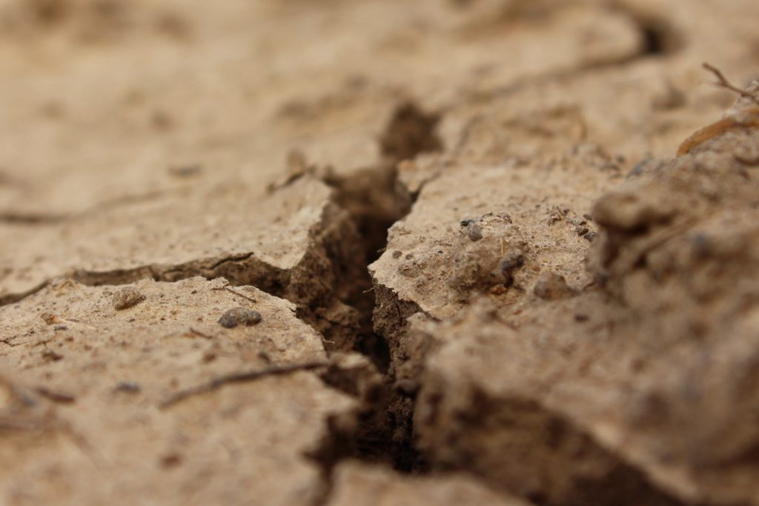
Hemp for Soil Remediation and Reclamation
Notes:
Hemp is used for soil remediation and reclamation.

Slide 52
Nutritional Products Hemp 3-D Printing Filament and Bio-plastics Many Other Products ______________ Phytocannabinoids: THC and CBD out of 100 other compounds
Notes:
It is used in many Nutritional Products, Hemp 3-D Printing Filament and Bio-plastics, and Many Other Products. In addition, the Phytocannabinoids for medical and recreational marijuana, notably THC and CBD, among over 100 other compounds.

Slide 53
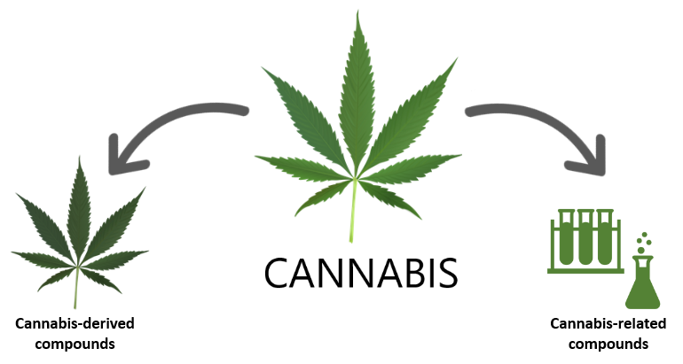
Epidiolex - V Marinol (dronabinol) - III
(cannabidiol), Syndros (dronabinol) - III
Cesamet (nabilone) - II
Sativex combines equal quantities of THC and CBD from two cannabis extracts.

Slide 54
Cesamet (nabilone) and Marinol (dronabinol), Syndros (dronabinol)

Slide 55
FDA-approved Epidiolex Lennox-Gastaut syndrome and Dravet syndrome

Slide 56
Agriculture Improvement Act CBD legalized federally

Slide 57
MORE Act - 11-19-2019 (Marijuana Opportunity Reinvestment and Expungement Act) Chairman Jerrold Nadler (D-NY) Representative Barbara Lee (D-NY)
10-2022 – President J. Biden - pardons

Slide 59
Still in 2022, THC is on Schedule I
Is THC unsafe and ineffective for any indication?

Slide 61
Supplemental
THC, CBD
AEA, 2-AG

Slide 62
Cannabinoids Modulate the endocannabinoid system activity
may have therapeutic potential in almost all diseases affecting humans, including obesity/metabolic syndrome, diabetes and diabetic complications, neuro-degenerative inflammatory, cardiovascular, liver, gastrointestinal, skin diseases, pain, psychiatric disorders, cachexia, cancer, chemotherapy-induced nausea and vomiting, among many others.

Slide 63
Clinical Endocannabinoid Deficiency (CECD) is a condition where individuals produce lower amounts of cannabinoids which are essential for health, vitality, and well-being. CECD may play a role in the following conditions:
Fibromyalgia Pain Anorexia
Depression Irritable Bowel Syndrome (IBS) Migraines
Parkinson’s Multiple Sclerosis (MS) (PTSD)Neuropathy
Huntington’s Motion Sickness
Autism Post-Traumatic Stress Disorder

Slide 64
CANNABINOID HYPEREMESIS SYNDROME
rare and only occurs in daily long-term users of marijuana.
Prodromal phase. Early morning nausea and belly (abdominal) pain. Fear of vomiting. Most people keep normal eating patterns during this time. Some people use more marijuana to stop the nausea. Lasts for months or years.
Hyperemetic phase. Ongoing nausea. Repeated episodes of vomiting often intense and overwhelming. Belly pain. Decreased food intake and weight loss. Symptoms of fluid loss (dehydration)
Many people take a lot of hot showers during the day. They find that doing so eases their nausea.

Slide 65
Runner’s High and Ananandanide!
‘Runner’s High’ - reductions in stress, pain and anxiety and sometimes even euphoria after exercise in some people. may result from Anandamide. not from endorphins.
Blocking opioid receptors with naltrexone, people still experienced euphoria and reduced pain and anxiety after exercise.
Meta-analysis of 33 published studies on the impact of exercise on endocannabinoid levels showed that: Acute exercise, including running, swimming and weightlifting, consistently raised the levels of anandamide, causing positive effects on mood.

Slide 66
Anandamide levels in CSF of chronic migraine patients versus controls, Sarchielli et al. 2007
Notes:
Sarchielli P, Pini LA, Coppola F, et al. Endocannabinoids in chronic migraine: CSF findings suggest a system failure. Neuropsychopharmacology. 2007;32:1384–1390

Slide 67
Rx of menstrual pain and cramps: Topical cannabis (creams, gels), provide local relief.

Slide 68
CBD Oil for Dementia Patients w/Behavioral Symptoms
Notes:
Medical marijuana will be used to treat dementia patients in the first major trial in the U.K. The trial is funded by Alzheimer’s Research U.K. and led by researchers at King’s College London.
Researchers will be testing a drug called Sativex, a peppermint-flavored mouth spray with both tetrahydrocannabinol (THC) and cannabidiol (CBD) ingredients. It’s already approved for some patients with multiple sclerosis. Scientists will monitor 60 patients between the ages of 55 and 90 who are living in care homes for the trial. They’re looking for people who experience aggression and agitation as symptoms of dementia in particular.

Slide 69
Autism spectrum disorder (ASD)
Lihi Bar-Lev Schleider, Ben-Gurion University of the Negev, Be’er-Sheva, Israel
https://www.nature.com/articles/s41598-018-37570-y

Slide 70
Acute effects of marijuana https://www.ncbi.nlm.nih.gov/pc/articles/PMC6650211/
Cardiovascular | Tachycardia, Vasodilation’ Orthostasis
Pulmonary | Bronchodilation, Hyperreactivity, Airway edema
Central nervous system | Anxiolysis, Anxiety, Paranoia/psychosis, Euphoria, Dizziness, Headache, Memory dysfunction, Analgesia
Gastrointestinal | Antinausea, Increased appetite, Abdominal pain
Endocrine | None

Slide 71
Induction dose of propofol in patients using cannabis
Cannabis users v. nonusers required for satisfactory clinical induction a significantly higher propofol dose to achieve laryngeal mask insertion.
Flisberg et al, Eur J Anaesthesiol. 2009 Mar;26(3):192-5. (Sweden), https://www.ncbi.nlm.nih.gov/pubmed/19237981/

Slide 72
Chronic effects of marijuana https://www.ncbi.nlm.nih.gov/pc/articles/PMC6650211/
Cardiovascular | Atheromatous disease
Pulmonary | Chronic bronchitis, Emphysema
Central nervous system | Similar to acute effects but tolerance develops, requiring higher doses for similar effects
Gastrointestinal | Cannabis Hyperemesis Syndrome
Endocrine | Gynecomastia, Anovulation, Galactorrhea

Slide 73
Cannabis use disorders ~ doubled risk of MI post-op
Surgical candidates with active cannabis use disorders were nearly twice as likely as their non-user peers to suffer a heart attack after surgery.
Ladha et al, Toronto, analyzed medical records of >4 million adults who underwent one of 11 major common elective procedures between 2006 and 2015. The propensity-score matched-pairs cohort consisted of 27,206 patients.
Anesthesiology, November 25, 2019.

Slide 74
Cannabis Withdrawal Syndrome
Signs and Symptoms:
Irritability/anger, Anxiety/depressed mood, Insomnia, Altered dreams, Anorexia, Abdominal cramping, Headaches, Tremors, Fevers/chills.
Onset: <1 day for high-dose, chronic users
Duration: Up to several weeks
Treatment: Symptomatic therapy; synthetic THC

Slide 76
Driving Under the Influence
DUI of marijuana is illegal. Basis for arrest: driving conduct; marijuana odor; statements; demeanor; field sobriety test performance; presence of cannabis in vehicle;
Penalties for 1st-time cannabis DUI conviction
<6 months of jail time; < $1000; suspension of driver’s license suspension < 6 months; 3-5 years probation; 3 months of mandatory DUI education classes; Subsequent marijuana DUI offenses will result in harsher penalties.

Slide 77
Can doctors smoke marijuana?
A physician cannot be impaired when practicing medicine whether they are using cannabis for medical purposes or for recreational use.
If the physician is impaired from cannabis and/or any other controlled substance or alcohol, the doctor puts their patient at risk and the Board would look into any physician who is practicing medicine while impaired.
The discipline that the Board can impose if it can prove that a physician has violated the Medical Practice Act can be as severe as license revocation.

Slide 79
Link to:
Marijuana Legal States:
US Map 2023
[UPDATED] | The Cannigma

Slide 81
Cannabimimetic
Plants
Mimic cannabis
Not derived from the Cannabis plant.
Phytochemicals (plant-chemicals) - plant foods, fruits and herbs.
Can act on the human cannabinoid receptors.
Involved in inflammation, oxidative stress, cancer, and neuroprotection.
Used by tribes and religious groups for thousands of years.

Slide 82
Over 200
Over 100
Over 300

Slide 83
Omega-3 Arachidonic Acid
Consuming higher levels of omega-3 polyunsaturated fatty acids (PUFAs) is associated with larger hippocampal volumes and better abstract reasoning in healthy middle-aged adults.
Research has also linked higher levels of omega 3s with better cognitive function and decreased risk for dementia in older individuals.
The main dietary sources of omega-3 include oily fish, such as salmon and sardines.

Slide 84
Cannabimimetic Plants: Cannabinoidergic modulators

Slide 85
Flavonoids found in Cannabis I
Some offer different therapeutic health benefits, e.g.,
Antioxidants (protection from cell damage)
Anti-inflammatory
Improving cardiovascular function
Neuroprotective
Anti-viral/anti-bacterial
Prevention against diabetes, cancer, and other diseases
Flavonoids contribute to the unique color of individual cultivars.

Slide 86
Terpenes found in Cannabis
Contribute to cannabis’ unique flavor and aroma.
Useful health benefits - addressing various health conditions.
Anticonvulsive
Anti-inflammatory
Anti-viral/anti-bacterial
Mood-boosting
Cancer/tumor-fighting
May help reduce anxiety in those affected by stress.

Slide 87
TERPENES in cannabis
Mercene - most abundant terpene in cannabis. (Also found in mangoes, thyme, and hops).
Produces a relaxing sedative effects - useful for sleep disorders like insomnia.
Muscle relaxation, gastric protection, and anti-inflammatory action.
Primary compound responsible for the “couch-lock” effects associated with cannabis (strong feeling of physical sedation, as if “locked” to the couch).

Slide 88
Also found in other plants:
pine, juniper, zingiberaceae (such as ginger, turmeric, cardamom),
mint, sage, thyme, caraway,
fennel, basil, tarragon, dill, parsley,mugwort, angelica, hemp, hops,
ylang-ylang, or serpolet.

Slide 89
Mango lemongrass
Thyme hops
Terpenes Present in above plants

Slide 90
Terpenes in Cannabis

Slide 92
WHAT IS A TERPENE CHART?
HOW TO READ IT?
Terpenes are inside every plant on the planet.
There are at least 20,000 currently identified.

