Slide 1


Medical Malpractice
Stress Syndrome
(MMSS)
Statistics
Cases
Symptoms & Signs
Management

Slide 2
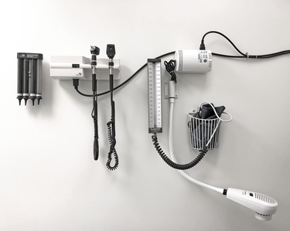
Medical Malpractice Statistics
34% were sued in 2016 (AMA Report)
16.8% have faced 2 or more lawsuits
65 year-old physicians, >75% in lower risk specialties and 99% in higher specialty areas will have been sued
32% of lawsuits to medications
involve patient death

Slide 3
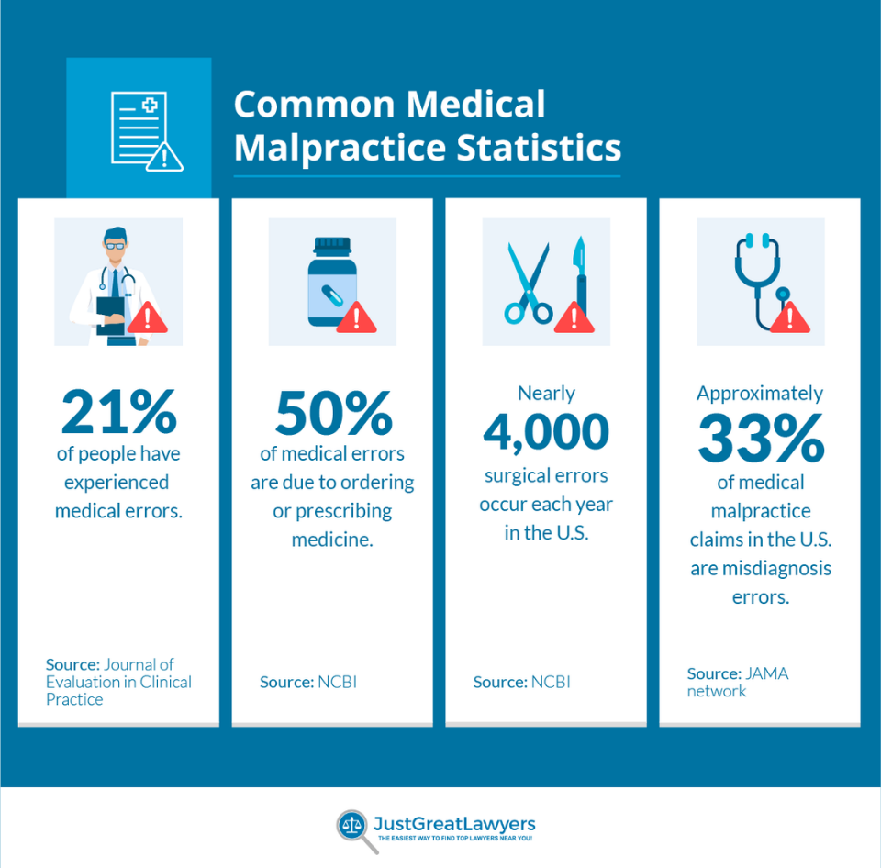

Slide 4
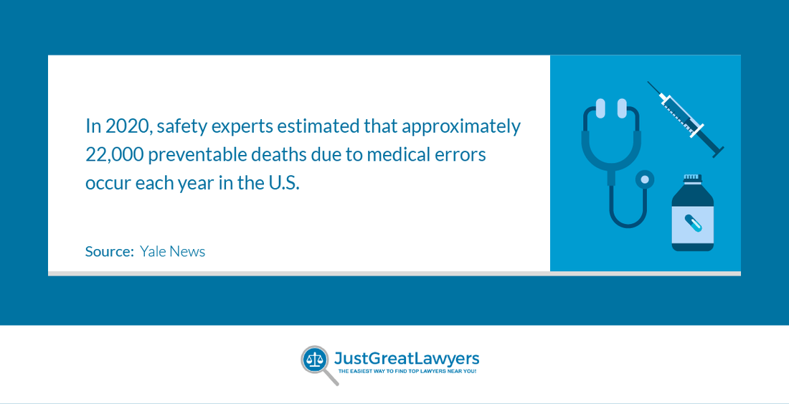
Preventable Medical Errors
Deadly Errors

Slide 5
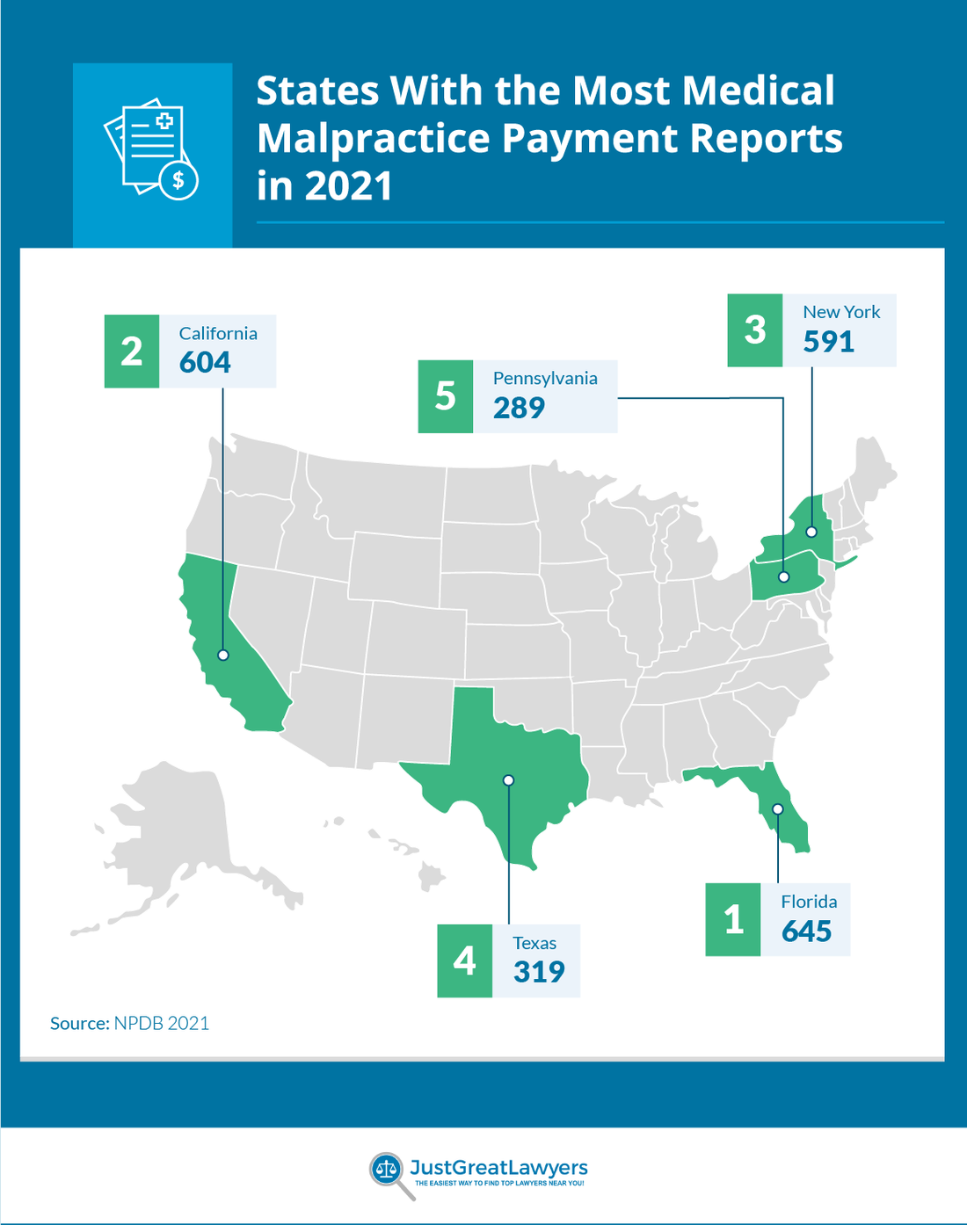


Slide 6

Outcome of Medical Malpractice Claims
~ 2/3 – Withdrawn, Dismissed, or Dropped
~ 1/3 – Settled
~ 7% - Full-Blown Trial; Doctors prevail in 88% of the verdicts

Slide 7

Medical Malpractice Payouts
Total payouts ~ $4 billion/year.
Quadriplegic or brain-damaged, or requiring lifelong care, average $961,185.
Major permanent injury ~ $610,000
Significant permanent injury ~ $450,000
Wrongful death - > $386,000.
Insignificant injury ~ $ 40,000.
Age and Gender
Greatest payments - 50-59 age group
Females received - 55.5% of payments
Males received - 44.2% of payments

Slide 8

Medical Malpractice in U.S.
Medical Errors - 10% of all deaths in U.S.
2020 - members of the armed services filed $2.16 billion in medical malpractice claims
Sexual contact with patients - 5% to 10% of all physicians
68 liability claims have been filed per 100 physicians.
49.2% of physicians age 55 and older sued.
39.4% of male physicians have been sued.
22.8% of female physicians have been sued.

Slide 9
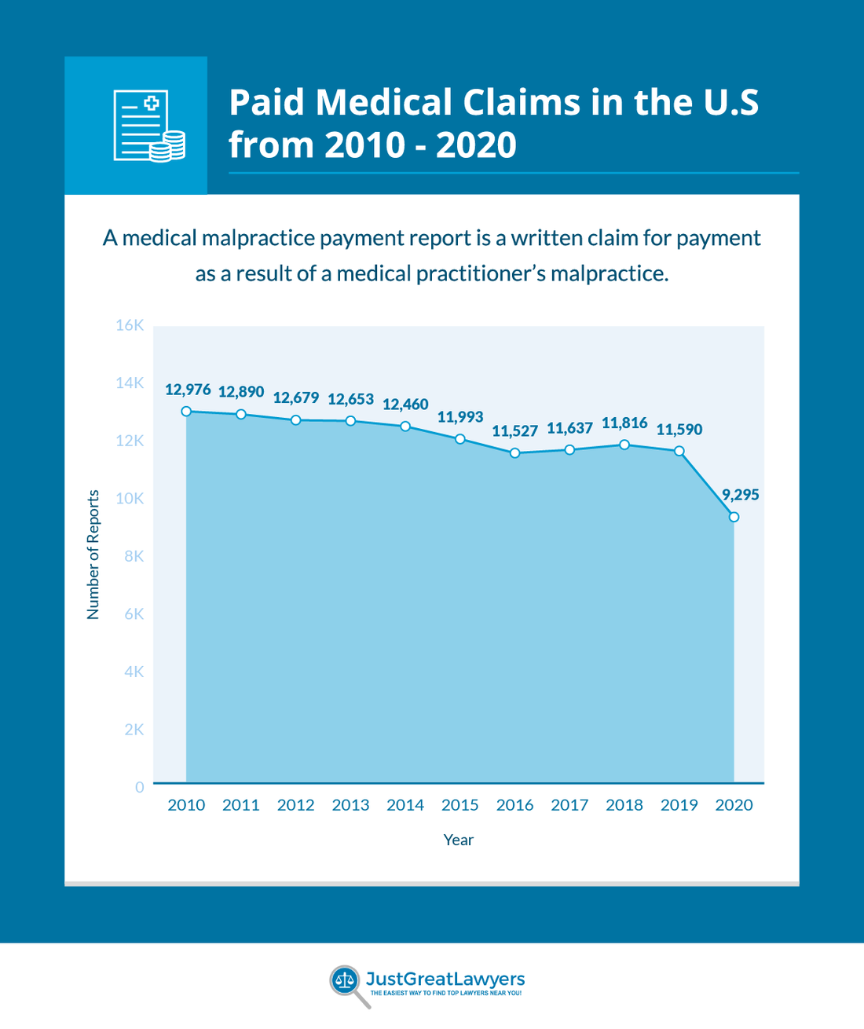


Slide 10
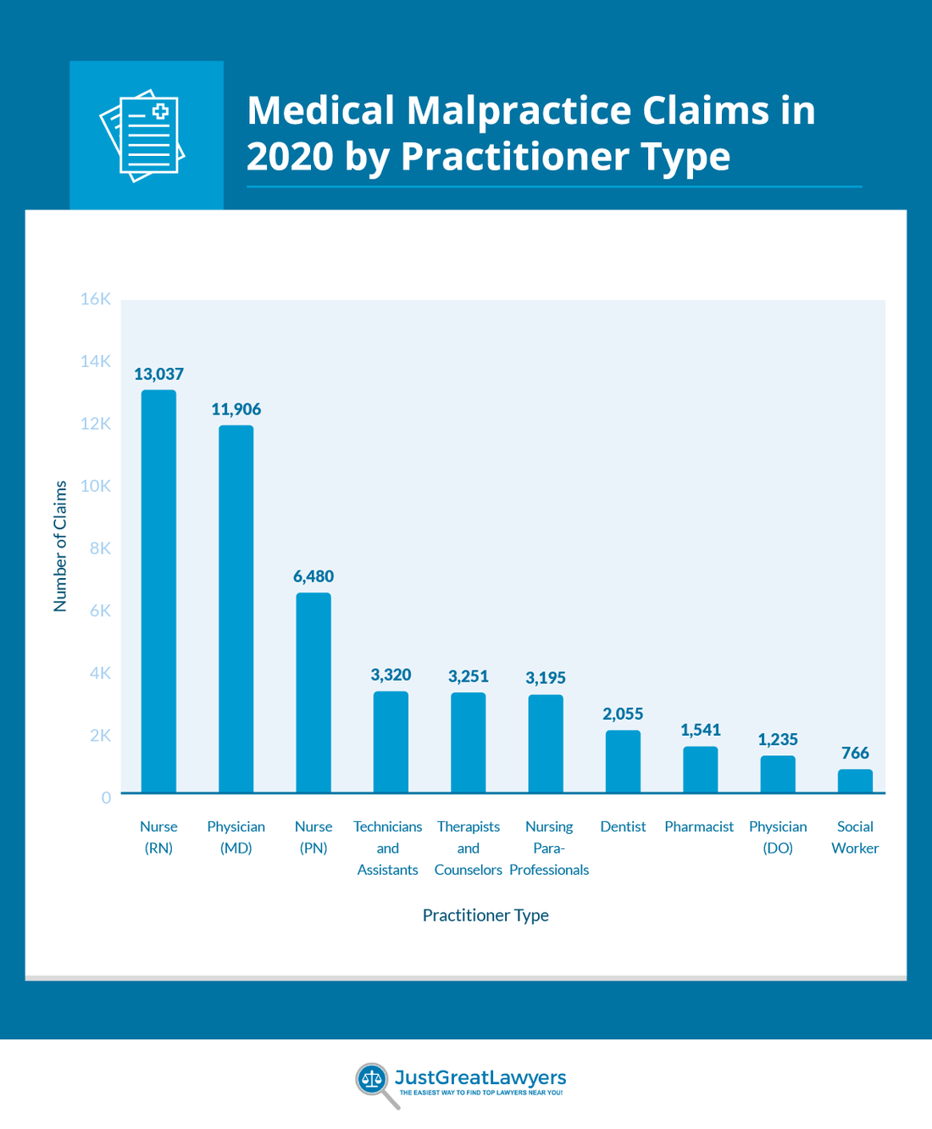


RN

Slide 11

Medical Malpractice Stress
95% of defendant physicians report that the malpractice litigation had a major psychological and/or physical effect on them.
Many describe their feelings about malpractice as the most stressful occurrence of their lives.

Slide 12

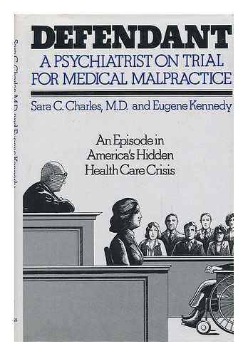
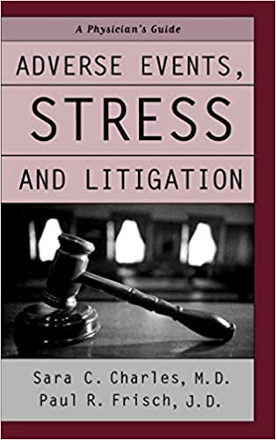
Sarah C. Charles, MD

Slide 13

MMSS Research
Impact of malpractice litigation
Sued and non-sued physicians - CMS
Changes in professional behavior and emotional reactions to both the threat and actuality of litigation.
Those sued reported significantly more symptoms and they were likely to stop seeing certain types of patients, thought of retiring early, and discouraged their children from entering medicine.

Slide 14

Effect on Health Care Delivery

Slide 15
Sunshine Family Medical Clinic
Dr. Ray Sunshine, 43 yrs., Board certified FP
January 11, 2001, Petition served by Sheriff
Initial reaction to lawsuit
Dr. Angela Sunshine, wife, informed; reaction.
Dr. Christopher Sunshine, father, informed.

Slide 16

Sheriff
Summons and Petition
Medical Malpractice Lawsuit

Slide 17

Dr. Ray’s Reaction
Stunned, shocked, dismayed
“All my patients love me. Who would do such a horrible thing?”
Flash backs
Staring at petition
Sweating, Shaking,
Trembling, Chest felt tight
Goose bumps
Weak, nauseated
Unstable on feet, dizzy

Slide 18

Angela Ray, MD

Slide 19
Three-Year Ordeal
Dr. Ray Sunshine’s litigation lasted 3 years.
Support & Help by Wife, Father, Close Friends, Relatives, Defense Attorney, & Insurance Co.
Dr. Ray’s MMSS: Anxiety & Depression.
Verdict for Dr. Ray

Slide 20
Litigation Stress
Predictable Hazard of Medical Practice.
Medical Malpractice Stress Syndrome (MMSS).
Physicians ill-prepared to deal with MMSS.
Effects of MMSS may be devastating.

Slide 21
MMSS: Manifestations
Worry; Restless
Difficulty concentrating
Guilt, shame, loneliness
Insecure, suicidal
Resort to drugs
Physical symptoms

Slide 22
When to Seek Professional Help?
        Medical
        Psychological

Slide 23
Discussions with:
    Family
    Friends
    Colleagues

Slide 24
Defense Attorney
      Rapport
      Trust

Slide 25
Essentials of Management:
    Confidence
    Players & Drama
    Knowledge
    Combat Stress

Slide 26
A Wound of the Heart
Fears of Losing:
  Control Livelihood
  Reputation Assets
  Supporters Outcomes

Slide 27
Education: Key to Deal with Fear
      Supportive Education
      Read about MMSS
      Seek Advice
      Ask Questions

Slide 28
What the Physician can do!
Transform one’s personal definitions
Pay attention to physician’s needs
Assemble a personal survival kit
Pay attention to needs of supporters

Slide 29
Derive Therapeutic Benefit by:
  Being active with defense attorney
  Participating in discovery
  Identifying expert witnesses
  Doing Medical literature search
  Preparing diligently

Slide 30
MMSS: Other Therapeutic Benefits
Attend all depositions
Learn about attorney tactics/trial
Learn about MMSS
Recognize insurer’s conflict of interest
Seek personal/private attorney’s advice when necessary

Slide 31
MMSS Rx
See a Family Physician, Internist, or Specialist to Treat Physical disorders;
See a Psychologist or Psychiatrist for Severe Anxiety/Depression.

Slide 32
Be Knowledgeable
Knowledge is Power which must be Acquired.

Slide 33
Other Resources:
  Litigation Stress Consultants
  Witness Preparation
  Medical Society Support Groups

Slide 34

“What does not destroy me, makes me stronger.” Nietzsche

Slide 35
What advice would you give to a Physician who is suffering from medical malpractice stress syndrome?
A certain amount of stress can be healthy and challenging.
When coping resources are not available, stress can be harmful and may lead to burnout and impairment.
To continue providing quality care to their patients, physicians must learn to effectively manage daily stressors.
All the above three answers (a, b, and c),

Slide 36
With respect to the Physician who is suffering from medical malpractice stress syndrome, one of the following answers is FALSE?
Physical, psychological, familial, spiritual, social, and occupational stressors may affect a professional’s level of functioning.
Burnout is a process that usually occurs sequentially, progressing through stages and giving a person an opportunity to recognize symptoms and take necessary steps to prevent it.
Intrusive thoughts or compulsions, feeling helpless or hopeless to change the course of events, and impulse to do something drastic or dangerous are ominous symptoms that require immediate attention.
Approximately 50 percent of physicians who are sued suffer physically and emotionally regardless of the outcome in court,

Slide 37
In a medical malpractice lawsuit, the most traumatic moment in the litigation process appears to be:
When the plaintiff’s expert witness makes a deposition criticizing the physician’s treatment or action,
When the lawsuit is filed.
When the trial begins.
When the Jury is deliberating behind closed doors.

Slide 38
Which of the following answers is FALSE with regard to Physicians who are suffering from medical malpractice stress syndrome?
Physicians who are sued experience a range of negative emotions that can have a paralyzing effect personally and professionally.
Response patterns are not similar to the grieving process (denial, anger/blame, bargaining, depression, and acceptance),
Malpractice litigation changes the physician-patient interaction significantly.
It is important for defendant Physicians to share feelings generated by the litigation process even though specific facts should not be discussed.

Slide 39
Coping successfully with malpractice litigation often requires:
Learning more about the legal process.
Accepting that litigation may take years to resolve.
Making use of support systems, such as colleagues, family members, and friends.
All the above answers (a, b, and c),

Slide 40
Which of the following answers is FALSE with regard to Physicians who are suffering from medical litigation stress?
The key to treating litigation stress is to try to avoid it altogether,
Resilience involves maintaining flexibility and balance in your life as you deal with stressful circumstances and traumatic events.
The tolls of unmanaged stress are addictive behaviors, relationship distress, emotional/behavioral problems, and professional consequences.
Government regulations and demands from insurance companies are considered the most stressful aspects of being a physician.

