Slide 1
Drug Prescribing
Optimizing drug therapy and
Avoiding adverse drug events (ADEs).

Slide 2
Process of prescribing
Drug is indicated,
Choose best drug,
Appropriate dose and schedule,
Monitoring effectiveness and toxicity,
Expected side effects, and
Consultation.

Slide 3
Pearl
After prescribing a new drug regimen, any new symptom should be considered drug-related until proven otherwise.

Slide 4
Medicare beneficiaries discharged from acute hospitalization to skilled nursing facility
Prescribed an average of 14 medications, and
Over one-third of the patients had medication side effects that could exacerbate their underlying geriatric problems.
Saraf AA, Petersen AW, Simmons SF, et al. Medications associated with geriatric syndromes and their prevalence in older hospitalized adults discharged to skilled nursing facilities. J Hosp Med 2016; 11:694.

Slide 5
herbal or dietary supplements
Ginkgo biloba, St. John's wort, echinacea, ginseng, garlic, saw palmetto, kava, and valerian root
Ginkgo biloba extract taken with warfarin, causes an increased risk of bleeding, and
St. John's wort taken with serotonin-reuptake inhibitors, increase the risk of serotonin syndrome.

Slide 6
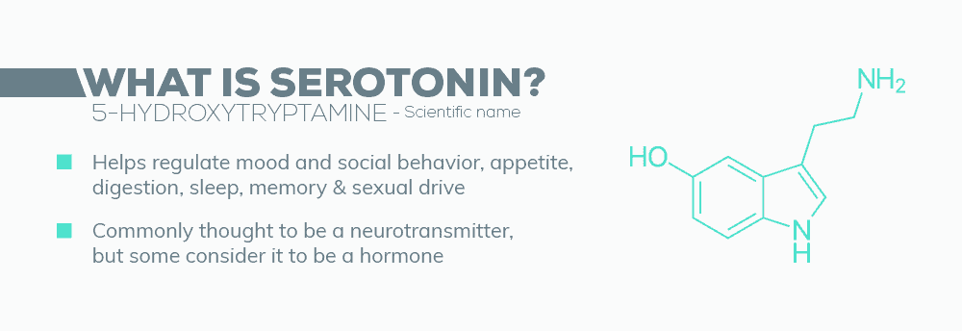
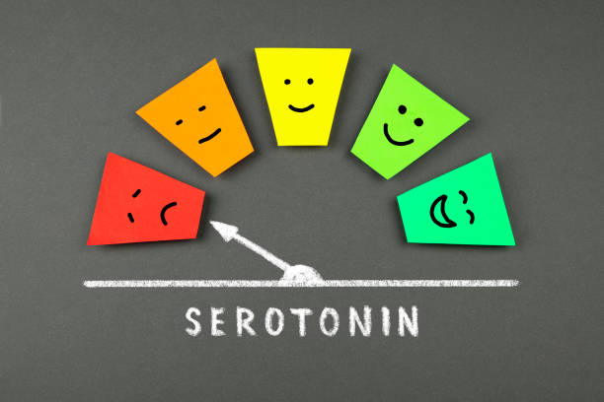

Slide 8
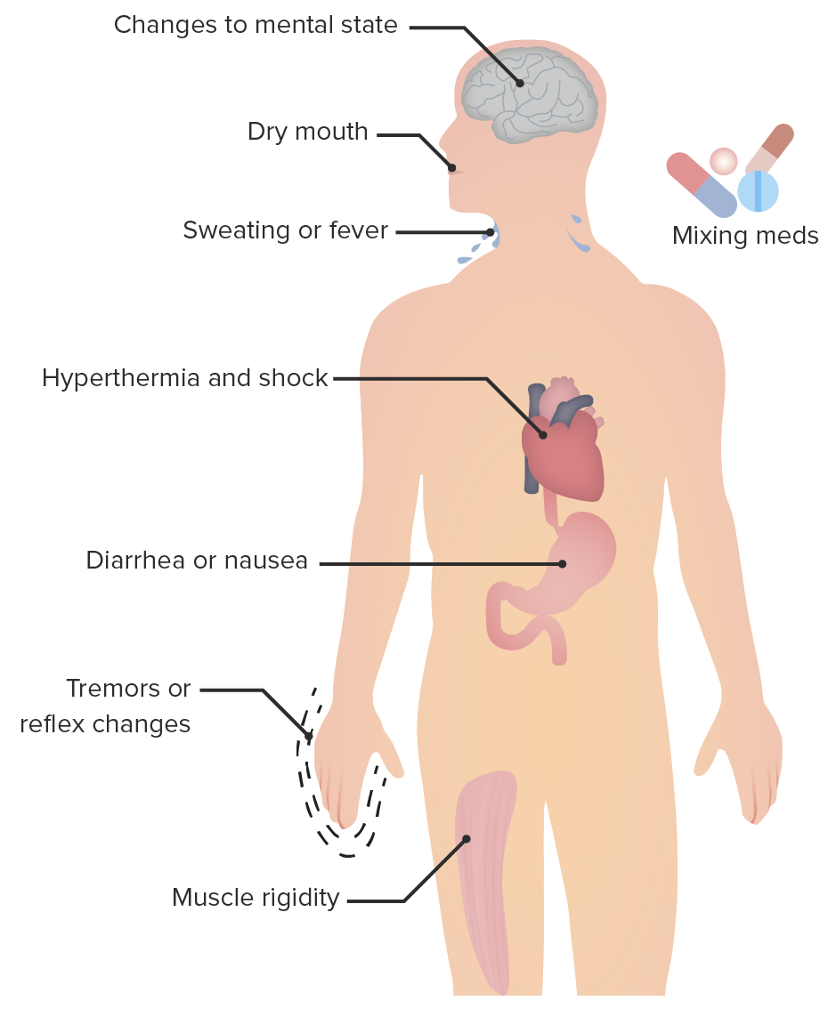
serotonin syndrome
Causes – Usually Medications
Complications – 2 or more drugs
Diagnosis – may be missed
Treatment – Remove drugs
Prevention – Be aware of side possible effects of drugs that increase Serotonin levels.

Slide 9
Selective serotonin reuptake inhibitors
Citalopram (Celexa)
Escitalopram (Lexapro)
Fluoxetine (Prozac)
Fluvoxamine (Luvox)
Paroxetine (Paxil)
Sertraline (Zoloft)

Slide 10
serotonin and Norepinephrine reuptake inhibitors
desvenlafaxine (Khedezla),
desvenlafaxine succinate (Pristiq),
duloxetine (Cymbalta),
levomilnacipran (Fetzima), and
venlafaxine (Effexor)

Slide 11
Monoamine oxidase inhibitors (MAOIs)
isocarboxazid (Marplan),
phenelzine (Nardil),
tranylcypromine (Parnate), and
transdermal selegiline (EMSAM)

Slide 12
Antidepressants that affect multiple serotonin receptors
vilazodone (Viibryd)
vortioxetine (Trintellix)

Slide 13
Other drugs that increase serotonin
Buspirone (BuSpar), to treat anxiety disorders
Trazodone (Desyrel), for depression or insomnia
Migraine treatments such as almotriptan (Axert), naratriptan (Amerge), rizatriptan (Maxalt), sumatriptan (Imitrex), and zolmitriptan (Zomig)

Slide 14
pain medications, especially opioids
fentanyl (Sublimaze, Fentora),
fentanyl citrate (Actiq),
meperidine (Demerol),
pentazocine (Talwin), and
tramadol (Ultram)
Dextromethorphan, a cough suppressant found in many over-the-counter and prescription cough medicines or cold medicines.

Slide 15
Certain medications for nausea
granisetron (Kytril),
metoclopramide (Reglan), and
ondansetron (Zofran)

Slide 16
Some recreational drugs
LSD
cocaine, and
dietary supplements, including St. John's wort and ginseng

Slide 17
Treatment of serotonin syndrome
Without Rx: can cause seizures, kidney failure, trouble breathing, coma, and death.
No single diagnostic test.
Medical history of drugs, supplement and recreational drugs
Lab test to rule out tetanus, heatstroke, sepsis of encephalomyelitis.
Periactin (cyproheptadine) in severe cases.

Slide 18
Polypharmacy and problematic polypharmacy
~ 20% of Medicare beneficiaries have 5+ chronic conditions and 50% receive 5+ medications.
84% of ambulatory cancer patients receive 5+ drugs, and
43 percent of cancer patients receive 10+ medications.
Increased risk for an adverse drug event (ADE), irrespective of age,
Increased risk of hospital admission, and
Decreased physical and cognitive capability.

Slide 19
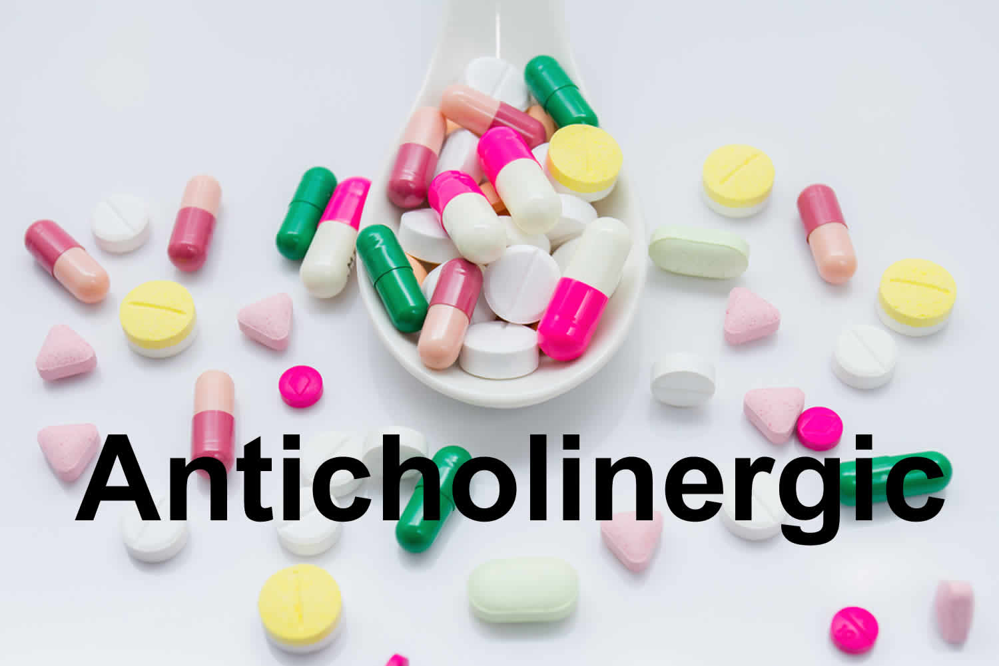
Inappropriate medications
Anticholinergic medications
Cognitive decline and dementia patients
Amitriptyline, atropine, clozapine, dicyclomine, doxepin, L-hyoscyamine, thioridazine, and tolterodine
Chlorpromazine, diphenhydramine, nortriptyline, olanzapine, oxybutynin, and paroxetine
Consider ADRs other than Anticholinergic – eg, dyskinesias and sedation with haloperidol and perphenazine.

Slide 20
Beers criteria
Medications are grouped into 5 categories:
Drugs potentially inappropriate in most older adults,
Drugs that should typically be avoided in older adults with certain conditions,
Drugs to use with caution,
Drug-drug interactions, and
Drug dose adjustment based on kidney function.

Slide 21
Other criteria sets
Screening Tool of Older Person's Prescriptions (STOPP) criteria
The FORTA (Fit FOR The Aged)
Centers for Medicare and Medicaid Services drug utilization review criteria
Assessing Care of Vulnerable Elders (ACOVE) project

Slide 23
STEPWISE APPROACH TO PRESCRIBING
Review current drug therapy
Discontinue unnecessary therapy
Consider adverse drug events for any new symptom
Consider nonpharmacologic approaches
Care in the use of common drugs
Reduce the dose
Simplify the dosing schedule
Prescribe beneficial therapy

Slide 24
CAREGIVERS MANAGING MEDICATIONS
Information sharing
Scheduling logistics and simplification
Safety issues
Polypharmacy

