Slide 1
The Reasonable Person Patient, Doctor, Judge & Juror

Slide 2
The reasonable person is the fictional or hypothetical) legal standard for lawful behavior at common law (case law).

Slide 3
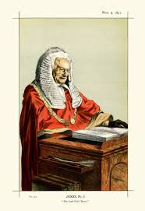
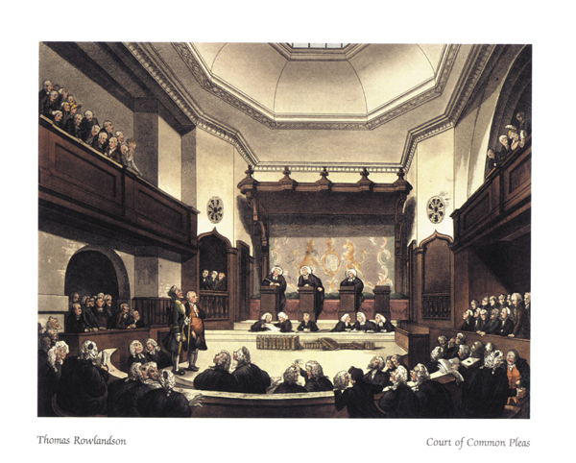
In 1837, the English court of common pleas established in Vaughn v. Menlove the reasonable person standard as ‘objective’.

Slide 5
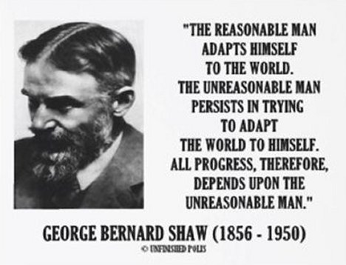
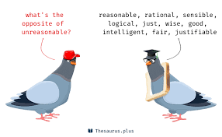

Slide 6
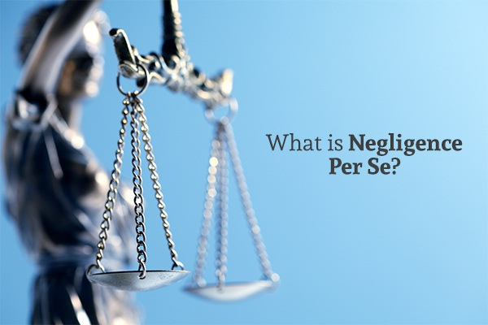
Unreasonable Conduct (1) Negligence per se
Means negligence by or in itself.
Violation of statute or regulation.
e.g. - DUI in a MVA
Reporting statutes – Failure to report certain medical disorders.

Slide 7
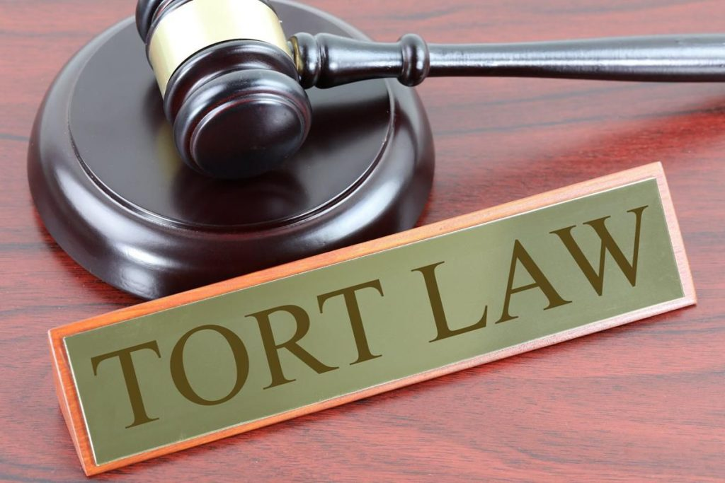
Unreasonable Conduct (2) Negligence as a matter of law
Undisputed fact or facts
Judge (not jury) declare negligence
Helling v. Carey - failure to administer a diagnostic test for glaucoma

Slide 8
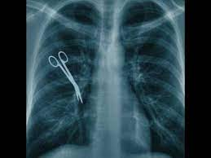
Unreasonable Conduct (3) Res Ipsa Loquitur
The thing speaks for itself
Doctrine or rule of evidence in tort law.
Inference or presumption that a defendant was negligent .

Slide 9
Unreasonable Conduct Byrne v. Boadle - 1863
Plaintiff was walking along a public street when he was struck by a barrel of flour falling from a window above and he evidently lost consciousness.
Facts were obvious.

Slide 10
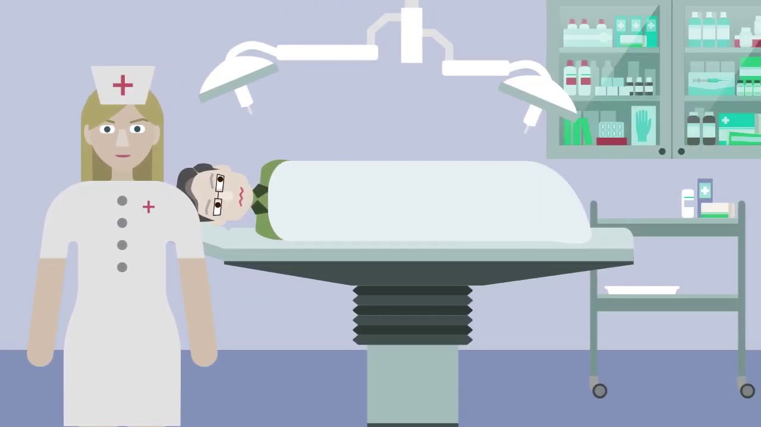
Unreasonable Conduct Ybarra v. Spanard – 1994 Injury while under anesthesia.

Slide 12
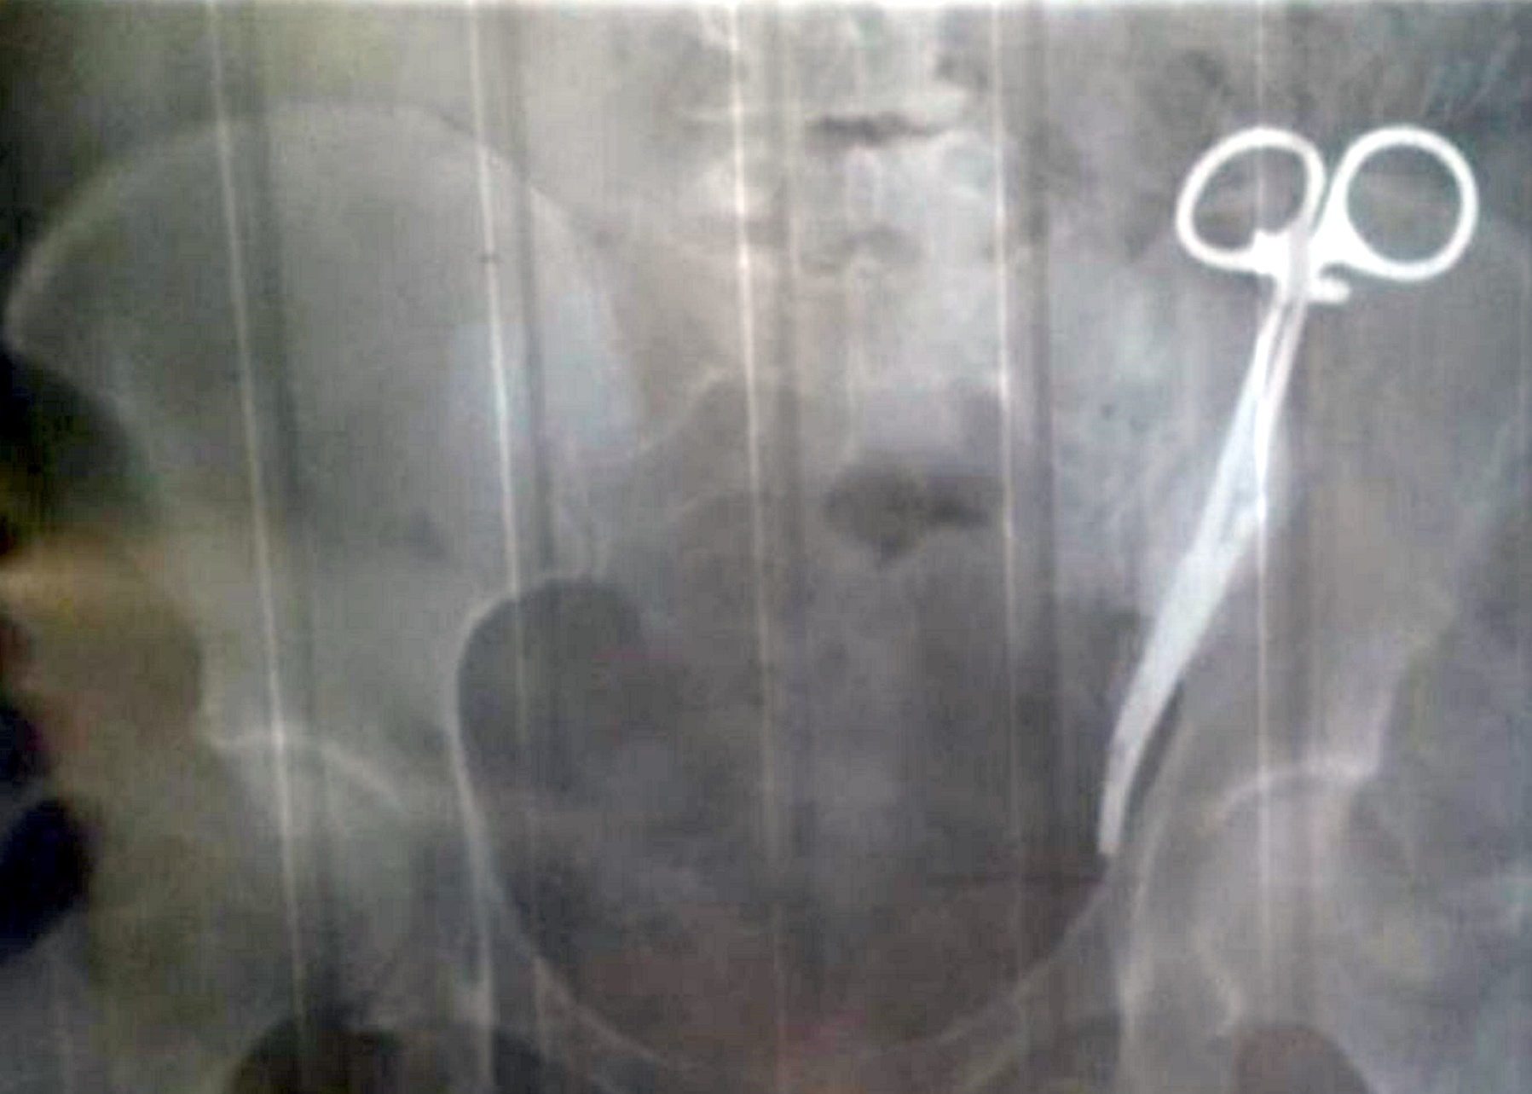
Unreasonable Conduct Clamp Left in Patient’s Abdomen

Slide 14
Blindness Exception to General Reasonable Person Standard

Slide 15
Children Exception to General Reasonable Person Standard

Slide 16
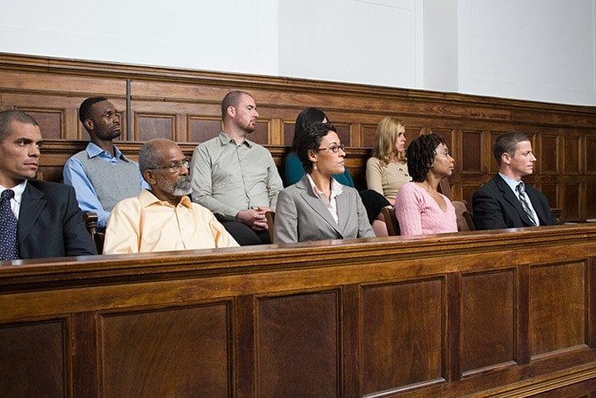

Slide 17
The T.J. Hooper U.S. Court of Appeals for the Second Circuit, 60 F.2d 737 (1932)

Slide 18
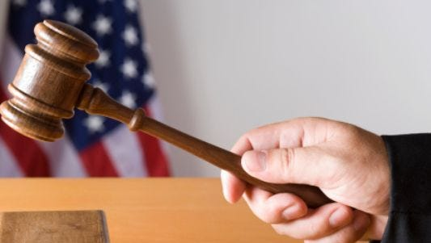
The T. J. Hooper The Judge held:
“Courts must in the end say what is required; there are precautions so imperative that even their universal disregard will not excuse their omission.”
In “most cases reasonable prudence is in fact common prudence; but strictly it is never its measure; a whole calling may have unduly lagged in the adoption of new and available devices.”
The owners of the two tugs were negligent in not anticipating the storm that sank the barges.
The tugs were not seaworthy in failing to have effective radio sets capable of receiving weather reports.

Slide 19
The Reasonable Doctor Davis v. Armacos
Standard: “reasonably competent health care provider engaged in similar practice and acting in similar circumstances.
Trial County Judge: Jury could consider what a layperson would deem reasonable standard of care.
Court of Special Appeals: “Medical malpractice claims are not general negligence claims …”

Slide 20
The Reasonable Doctor Davis v. Armacos
Maryland’s Court of Appeals reversed the Court of Special Appeals and affirmed the trial court's decision in favor of the plaintiff.
The Court characterized “any... medical malpractice tort” as a “traditional negligence claim.”
Thus, “the general principles which ordinarily govern in negligence cases also apply in medical malpractice claims.”

Slide 21
The Reasonable Juror
Prescriptive method - means that some right or obligation has become legally established or accepted by long usage or the passage of time.
Statistical method - reasonableness may be understood as what is average or common. It looks to the way in which actual people are in the habit of acting.
Hybrid method – Combination of 1 & 2

Slide 22
Reasonable Informed Consent
Post-World War II Nuremberg Code - U.S.A. v. Karl Brandt et al, (also known as the Doctors' Trial) – 1946-47
The Belmont Report - 1979
A person of the age of majority and sound mind has a legal right to determine what may be done to his or her body.

Slide 23
Canterbury v. Spence - 1972
“the standard measuring [physician] performance…is conduct which is reasonable under the circumstances”.
Instead of adhering to the community disclosure standard, physicians are now required to disclose information if it is reasonable to do so.

Slide 24
Other disclosures to Patients
1979 - Gates v. Jenson - personal or economic interests that may influence the doctor’s judgment.
2010 - Jandre v. Physicians Insurance Co of Wisconsin - disclose all diagnostic tests that may rule out a possible condition.
1980 - Truman v. Thomas, - informed refusal, woman had refused a pap smear.

Slide 25
Exceptions to Informed Consent
The incapacitated patient;
Life-threatening emergencies with inadequate time to obtain consent, and
Voluntary waived consent.

Slide 26
Children (typically under 17) who can provide informed consent
Children under 18 years of age and married;
Mothers of children (married or not),
Those under 18 who are serving in the military; and
Those who are able to prove financial independence.

Slide 27
Standards for informed consent
Subjective standard: What the patient herself or himself would need to know and understand in order to make an informed decision.
Reasonable patient (materiality) standard: What the average patient would need to know to be an informed participant in the decision. Lack of informed consent is established in court when a reasonable person in the position of the patient would have decided against the treatment.
Reasonable (prudent) physician standard: What a typical physician would say about this procedure.

Slide 28
P-P Shared Decision Making
Regardless of which standard is applicable to any given case, or what state definition applies, informed consent should involve elements of both the patient and physician standards, thereby bringing together concepts of shared decision making.

Slide 29
Conclusion
The legal standard for lawful behavior is the objective reasonable person, a fictional or hypothetical person who approaches any situation with the appropriate amount of caution, and then takes action sensibly.
Unreasonable conduct situations include:
Negligence per se;
Negligence as a matter of law; and
Res Ipsa Loquitur.
Informed consent and refusal varies in states.

