Slide 1
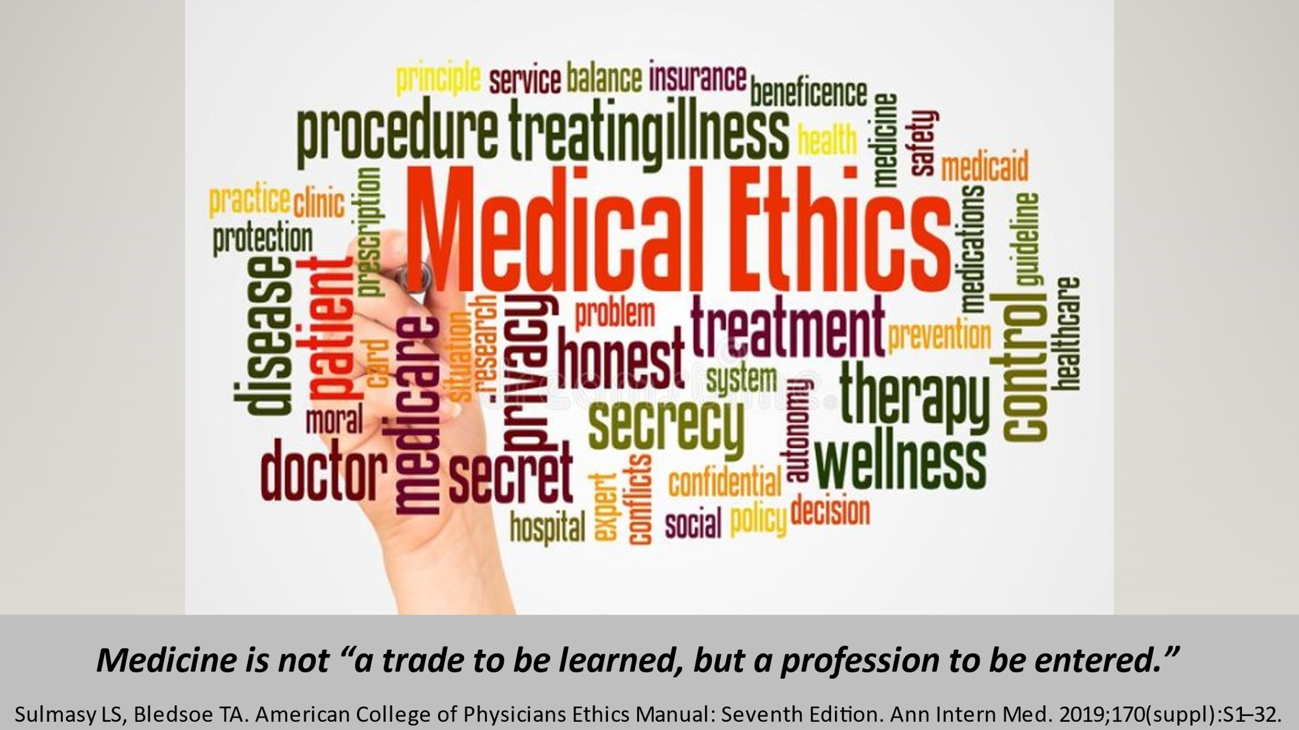

Slide 2

medical profession characteristics
Specialized Knowledge;
Code of Professional Ethics;
Legal Duty to serve patients;
Self-Regulation.

Slide 3

Governance of Medical Profession
Constitutions
Statutory law (Statutes);
Judicial laws (Common law);
Rules and regulations; and
Professional medical ethics

Slide 4
Medical profession: Social Contract
Physician
Public
Patient
1st Party
2nd Party
3rd Party

Slide 5
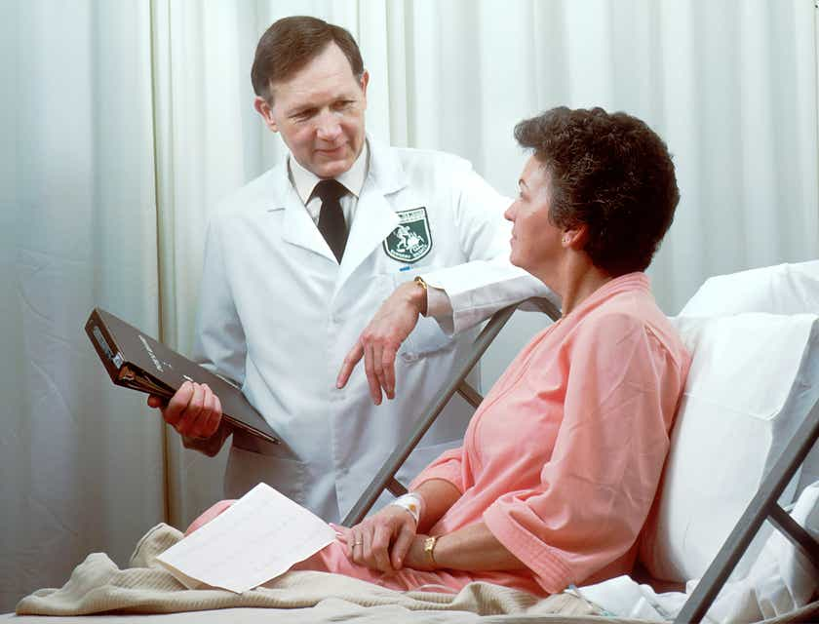
Physician’s DUTIEs
Fulfill the role of the healer
Access to health care
Honest, trustworthy, transparent, accountable, moral with integrity
Proﬁcient in medical knowledge
Promote the public good

Slide 6

Society (patient and public) obligations
Create and maintain a healthcare system
Accept some responsibility for their own health
Trust clinicians; provide them autonomy
Balanced lifestyle

Slide 7
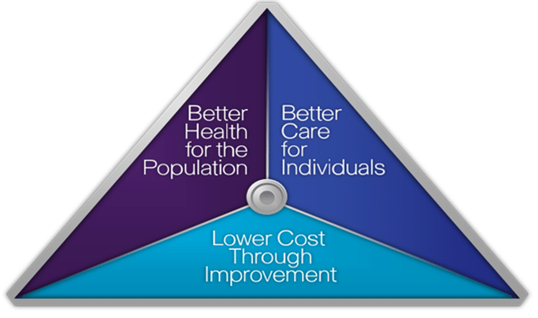
Institute for
Healthcare
Improvement
Triple Aim
of Healthcare

Slide 8
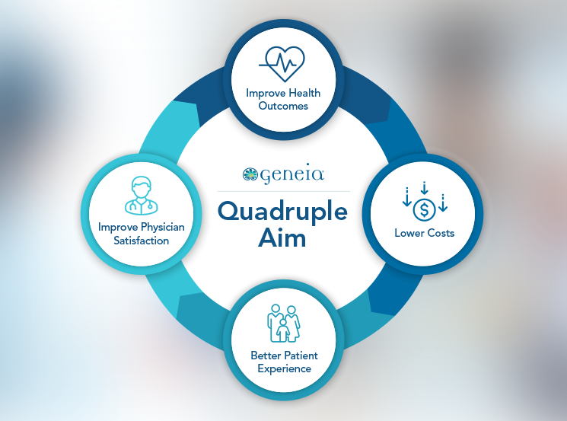

Slide 9

Quadruple Aim Issues
Continuous assessment of clinician satisfaction and well-being
  Issues with EHRs
  Improve work life of clinician
Clinician satisfaction must not detract from achieving the Triple Aim .

Slide 10
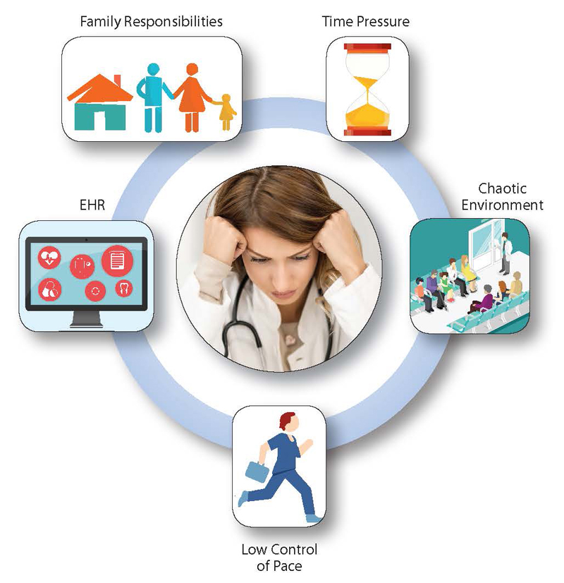
challenges to
Well-Being of Clinicians
Consolidation of medical practices
Higher productivity expectations;
Reduced reimbursements;
Legislative and regulatory requirements;
EHRs issues and increased clerical burden.

Slide 11
Clinicians’
EtHICAL issues:
2. Disruptive behavior
1. Burnout
3. Impaired clinician
4. Boundary violations
5. Alcohol & drug abuse

Slide 12

Occupational phenomenon
Excessive levels of work-related emotional exhaustion
Quality marker

Slide 13

Ramifications of Clinician Burnout
Medical errors;
Disruptive behavior;
Decreased productivity;
Alcohol abuse, broken relationships, depression, suicide;
Lower quality of care; and
Decreased patient satisfaction.

Slide 14
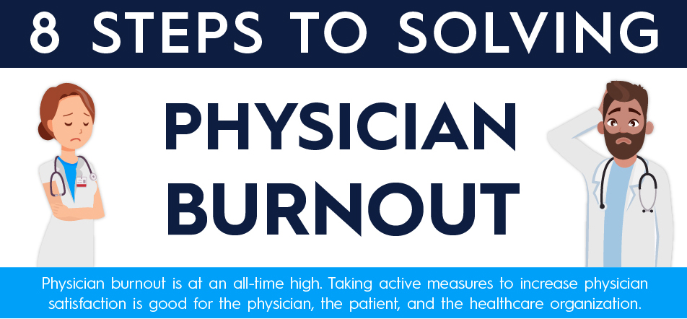
Treatment of Clinician Burnout
  Individual-focused programs Address administrative burdens
  Improve the workplace Medical specialty societies
  Policy changes at all levels

Slide 15


Slide 16

Disruptive Clinicians
Disruptive clinician conduct - verbal threats, refusal to cooperate and, more severely, to physical threats or throwing of objects.

Slide 17
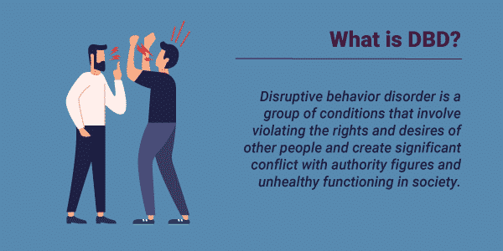

Slide 18

Symptoms of Disruptive Physician
  Profanity; Name calling;
  Sexual, Racial/ethnic jokes,
  Outbursts of anger,
  Intimidation, Nonadherence,
  Criticizes healthcare team,
  Absences or tardiness,
  Avoids peers or superiors,
  Unusual work hours.
Red Flags

Slide 19

Signs of Disruptive Physician
Irritability,
Fatigue,
Disheveled appearance,
Changes in weight,
Observed heavy drinking or drug use,
Slurred or pressured speech,
Disorganization and poor attention.

Slide 20

Disruptive Physician: help & Treatment
  Identify disruptive behaviors
  What contributes to triggers
  Corrective action, educational and training programs, rehabilitation, and monitoring
  Nurse-physician-staff relations committees
  Physicians should be “upstanders,” not bystanders

Slide 21

Impaired Physician
  Prevalence estimates - 2% to 14%
  Alcohol abuse most common
  Depression – difficult to quantify
  Work-related stress exacerbates anxiety and depression
  Usually function adequately
  Cognitive impairment or dysfunction due to age or disease

Slide 22

Identifying and Reporting Impaired Physician
Recognizing and confidentially
Personal difficulties
Professional performance
Changes in mood or behavior
Overt intoxication

Slide 23
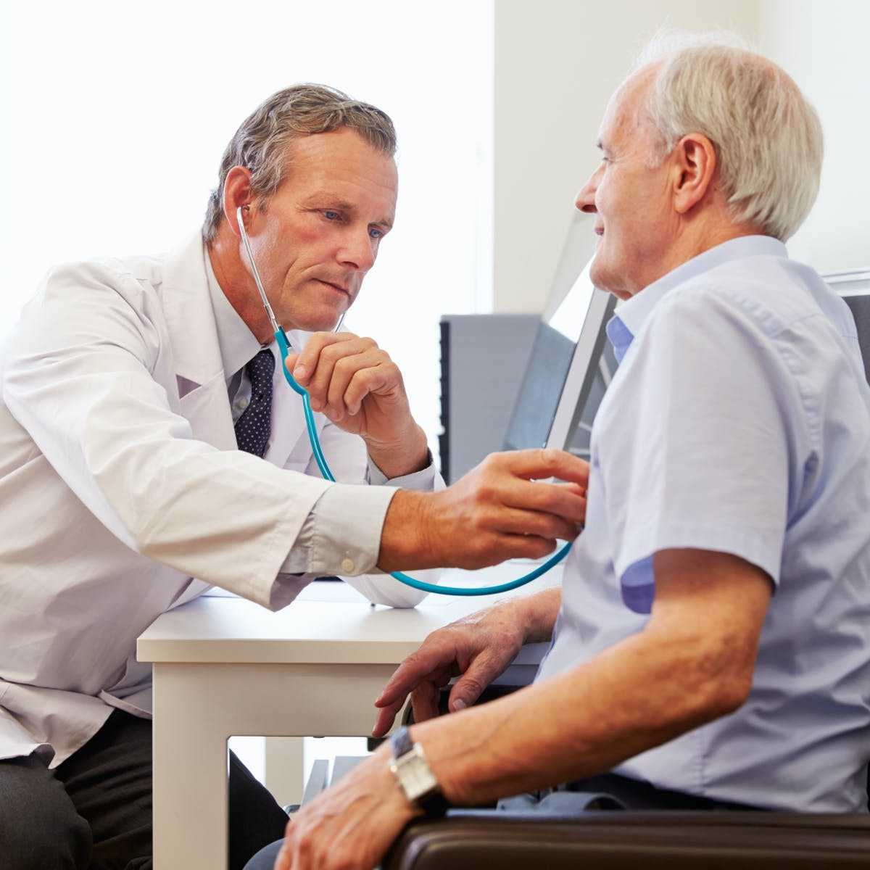
Treatment of Impaired Physician
Family and friends
Colleagues or supervisors
Team trained in interventions
Programs to treat & rehabilitate
Re-entry into practice.
Stigma of seeking mental health.

Slide 24
Boundary violations include:
Misrepresentation credentials;
Inadequate informed consent or informed refusal;
Disruptive behavior;
Drug abuse or diversion;
Inappropriate use of social media;
Financial irregularities; and
Sexual misconduct.

Slide 25
Types of Boundary violations
Non-patient violations
e.g. sexual harassment and prescribing to non-patients
Patient nonsexual violations
e.g. mis-prescribing, inappropriate behavior while examining patient
Patient sexual violations
e.g. with current and former patients of actively practicing physician

Slide 26
Slippery Slope Concept
Boundary violation typically starts small, then escalate.
Slippery slope concept.
Doctor is always responsible, eve if the patients initiates the relationship.
Even if a minor violation occurs,
it is better to transfer the patient.
Notes:
The doctor is responsible for preserving the boundary and he should ensure that boundary violations do not occur. If even a minor violation occurs, it is better to transfer the patient to a colleague. The boundary violation typically starts small and become incrementally problematic and the dyad starts sliding down the slope. This is known as Slippery Slope Concept.

Slide 27
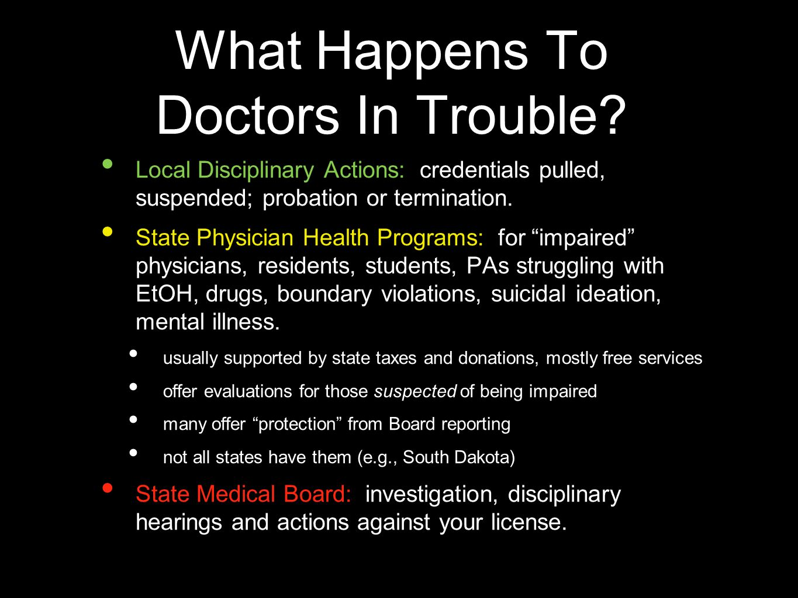


Slide 28
Substance Use Disorders:
Alcohol & Drug Abuse by physicians
2015 – Oreskovich et al - 27,276 physicians received invitation to participate, 7,288 (26.7%) completed surveys.
12.9% of male physicians and 21.4% of female physicians met diagnostic criteria for alcohol abuse or dependence.
Abuse of prescription drugs and use of illicit drugs was rare.
Prognosis for recovery is exceptionally high.

Slide 29
COVID-19 Impact on alcohol drinking
2021 Medscape survey - 12,000 US physicians from 29 specialties responded to the survey between August and November 2020.
About 42% of doctors reported experiencing symptoms of burnout, and more than a quarter of respondents said they drank alcohol to cope with these symptoms. The pandemic appears to have exacerbated drinking across all medical specialties.
Physician Lifestyle & Happiness Report 2021

Slide 30

Professional Ethics
Patients and Society (The Public)

Slide 31
Medical profession: Social Contract
Physician
Public
Patient
1st Party
2nd Party
3rd Party

Slide 32
Duty to Warn or notify
Non-Identifiable
(Forseeable)
Identifiable
3rd Party
Family
Member
Physician
Public
Patient
Reporting Requirement
EOT
(Expedited Partner Program)
1st Party
2nd Party
3rd Party

Slide 33
California (17 CCR § 2636)
“An effort, through the cooperation of the patient,” should be made to bring the third party in for examination and treatment.
If the physician does not have evidence that the third party received treatment within 10 days, the physician must report the suspected case to the health department.
Indiana (410 IAC 1-2.5-75), if a patient identifies a third party as someone potentially exposed, this “suspected case” should be reported to the local health officer

Slide 34
Professional Ethics - terms
Ethics
Bioethics
Medical Ethics
Morality

Slide 35
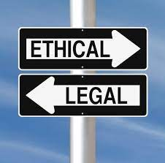
Relation of Medical Ethics to the Law
Ethics applicable nationally
Ethics higher standards of behavior
Federal and state laws differ
Licensing boards & officials actions
Law may mandates unethical conduct.

Slide 36

Nonmaleﬁcence - do no harm;
Respect for autonomy - free and uncoerced choices;
Beneﬁcence - best interest of the patient; and
Justice - be fair, reasonable and equitable in matters of health care and society
Major

Slide 37
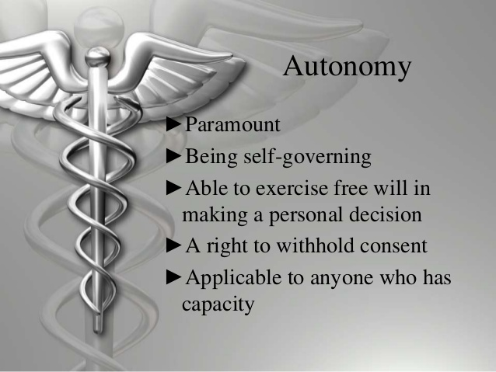
Consider also:
Individual Values
Goals
Preferences
Informed Consent
may be insufficient.

Slide 38
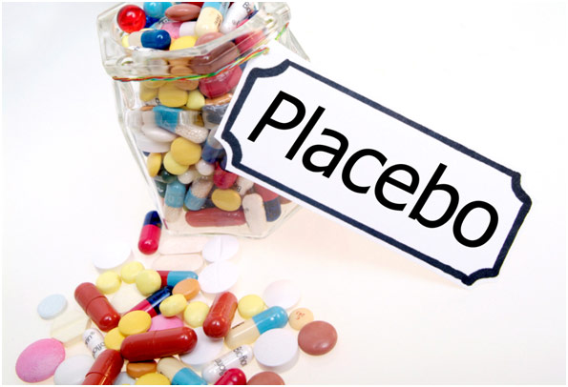
exception to autonomy
Beneficial to the patient
Informed consent
May deliberately mislead patient
Ethical - not to patient’s detriment
Factors that enhance placebo effect
Document as ”adjunctive” Rx

Slide 39

Access to quality health for all Americans
Inequities in health care and outcomes
World Health Organization view
Allyship

Slide 40

Other Principles of Medical Ethics
Honesty (Dishonesty)
Conflicts of interest
Confidentiality
Respect; Integrity
Competence & EBM
Prof. responsibilities
Access and distribution

Slide 41
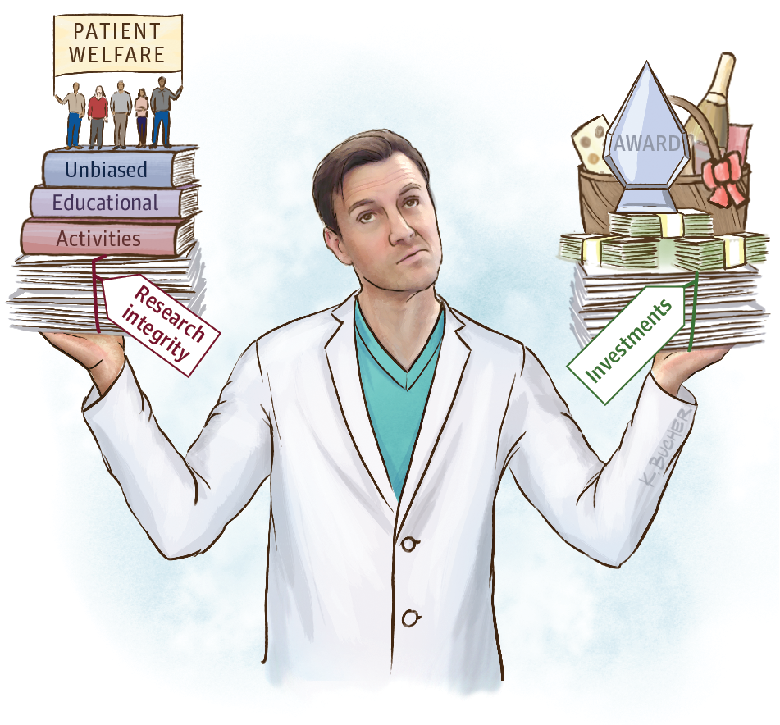
Conflict of interest
Primary Interest – Patient Welfare
Secondary Interest – personal gain, financial or other

Slide 42

Patients who lack confidence in medicine
Prior adverse outcome
Friends - Victims of negligence
Differential treatment
Patient on Alternative therapy
Patient questions care

Slide 43
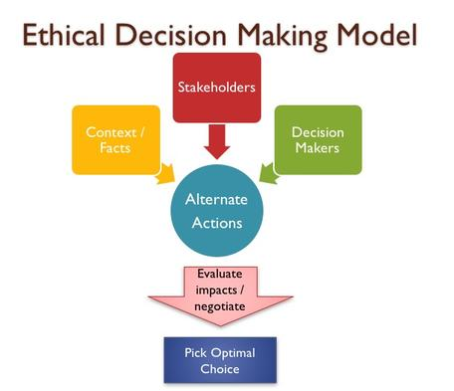
Three Approaches
Non-rational approach - Habit, Obedience, Imitation, and (Gut) Feeling or Desire, Intuition.
Irrational approach –What has the patient got to lose?
Rational approach – Major Ethical Principles, Utilitarianism, Cost-effectiveness and Quality of life, among others.

Slide 44
Patient-Centered Care
Grounded on patient autonomy and optimizes the outcomes
Agreement versus disagreement on desired outcome
Clinical information alone is insufficient
American versus other cultures
Does not require the provision of any care requested by patient
Document patient-centered recommendations

Slide 45
Shared Decision-Making (Formal process)
Shared decision making is a formal process
  Patient decision aids,
  Decision coach, or
  Multidisciplinary team of healthcare workers
CMS has included it nationally
Reserved for decisions with signiﬁcant tradeoffs
Barriers: space, time, expertise and payment

Slide 46
Patient Decision Aids
Evidence-based tools
  Improve knowledge, satisfaction, communication;
  Increase patient involvement in decision making; and
  Reduce patient decisional conﬂict and regret.
Paper forms, audio, video, in-person lectures, interactive websites, webinars, and other educational media.
International Patient Decision Aid Standards

Slide 47

Doctor Biases About Patients - 2021
https://www.healthgrades.com/pro/avoid-these-7-common-doctor-biases-about-patients?CID=64embrdTINL060121

Slide 48

1. Emotional
Problems
Diagnostic
Overshadowing

Slide 49

2. Obesity

Slide 50

3. Low Intelligence

Slide 51

4. Language Differences

Slide 52

5. Lack of
Insurance

Slide 53

6. Age Bias

Slide 54

7. People of
Color - racism

Slide 55
Achieving Public Health Goals
Shift focus from patient to community or population beneﬁt
Tension between “autonomy” and “justice”
Countervailing forces of “privacy” and “public health”

Slide 56
Scientific and Technological Advances
Medicine is experiencing an exponential evolution and change
Telemedicine and Remote monitoring
Changes in business models
EHR, coding and billing challenges and reimbursement burdens

Slide 57
Employed Clinician Professionalism
Pay-for-performance programs, aka value-based payment programs
Programs that reward select quality measures
Evidence-based treatment should take into consideration patient goals, values and preferences;
Clinician is responsible

Slide 58
Documentation in medical records
Patient safety - primary goal .
Truthful and accurate, private, secure, and transparent.; clear, concise but thorough, legible if hand-written, organized, veriﬁable, and completed in a timely manner.
Medical scribes
Copying and pasting

Slide 59
Ethical coding and billing practices
Policies and procedures
Veriﬁed and audited clinical documentation
Consistent with the complexity of decision making and the clinician time.
Volume of documentation
Avoid upcoding

Slide 60
EHR information – Ethical and Legal concerns
Information belongs to and should be accessible to the patient
EHR itself belongs to the clinician or hospital
Concerns: Vulnerabilities; Security; Inaccurate information; upcoding and cloning; distraction from patient; and loss of clinical contest
Leading cause of burnout
Team-based care support
Patient portals

Slide 61
Conflict of interest in New Models of Care Delivery
Changes to the delivery of health care
Potential conflicts of interest
Overtreatment versus undertreatment
Clinicians with financial interests in alternative sites of care

Slide 62


Slide 64
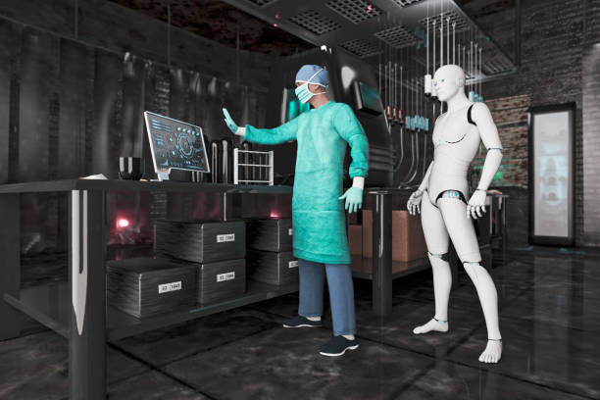

Healthcare Technology
(HealthTech)

Slide 65
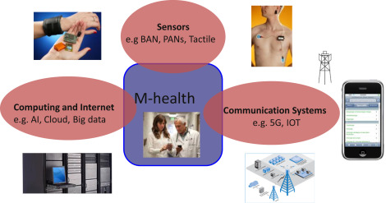

Slide 66

Legislation
2021 – Arizona

Slide 67
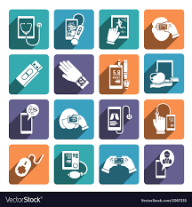
Digital health

Slide 68
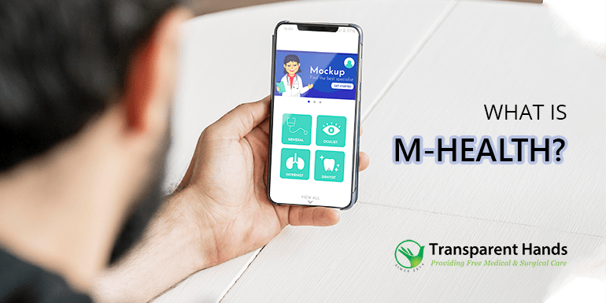
Medical or public health practice supported by mobile devices

Slide 69
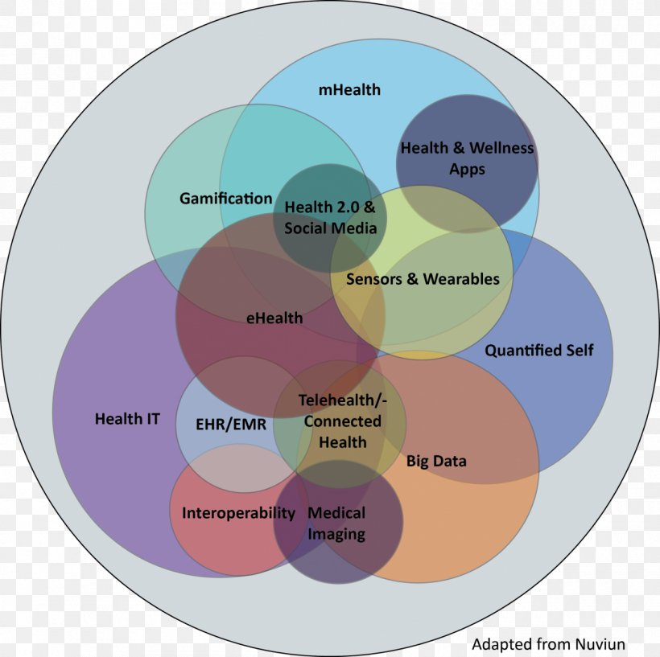
Healthcare Technology
Information technology (IT)
IT tools provide real-time, data-driven choices.
MIT Technology Review Insights, with GE Healthcare -current AI health products and services.

Slide 70
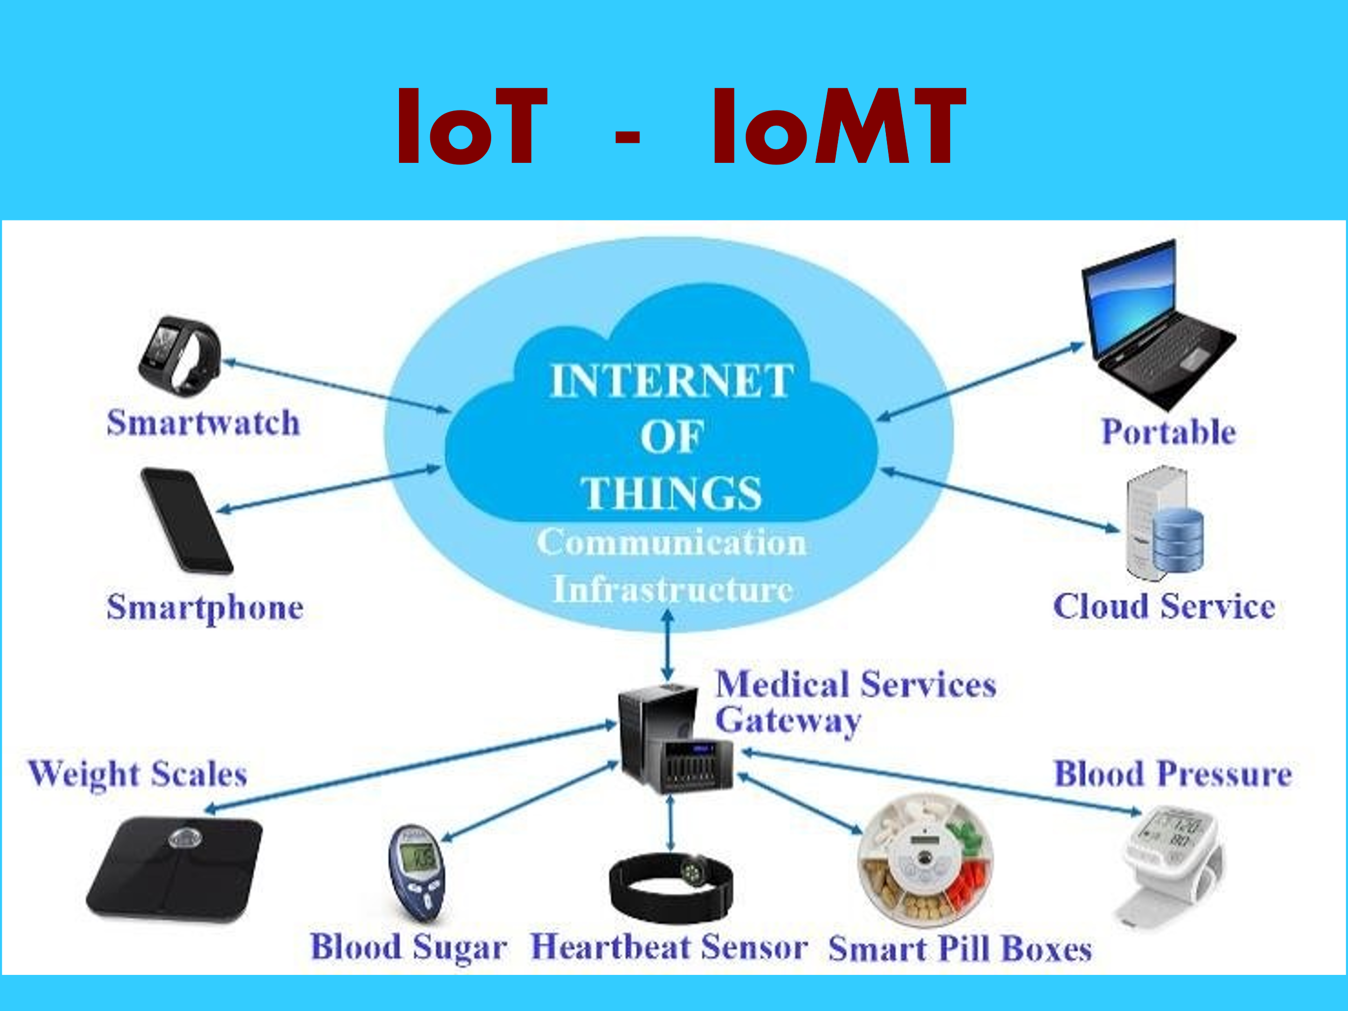

Slide 71
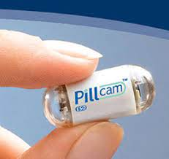
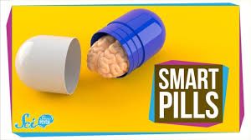
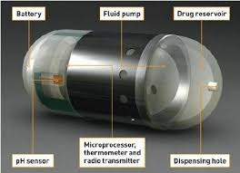
Fda approved

Slide 72
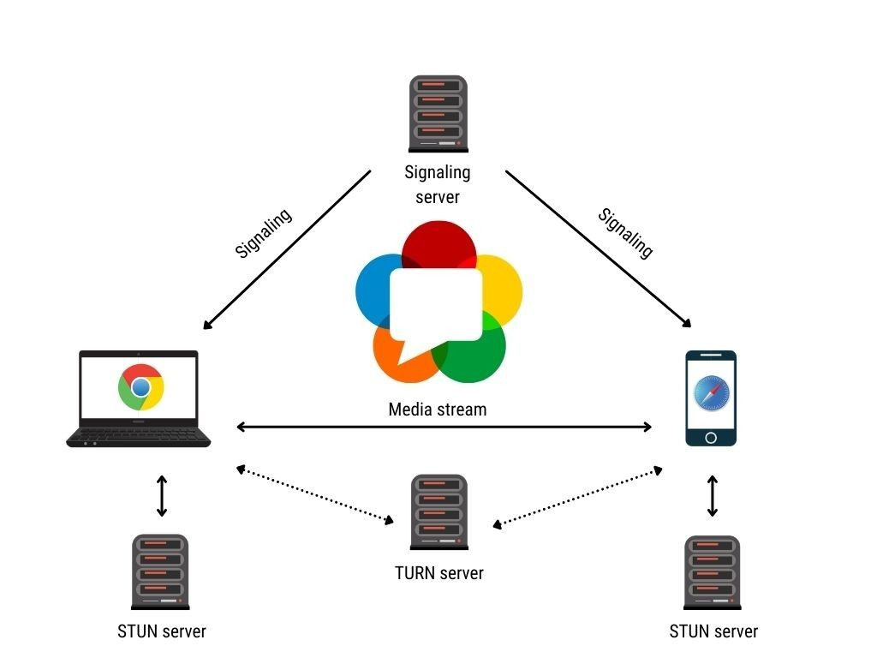
WebRTC
(web real-time connections)
API (Application Programmable Interface) based system
WebRTC

Slide 73
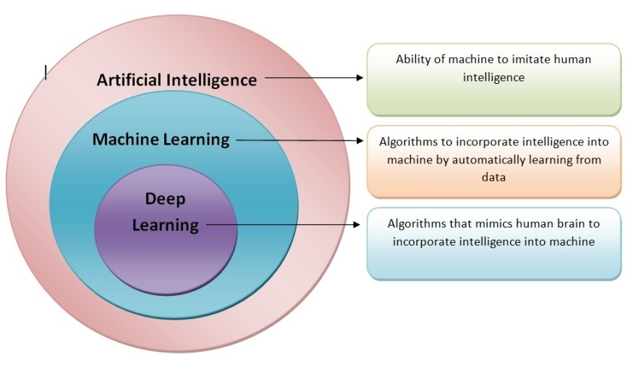

Slide 74
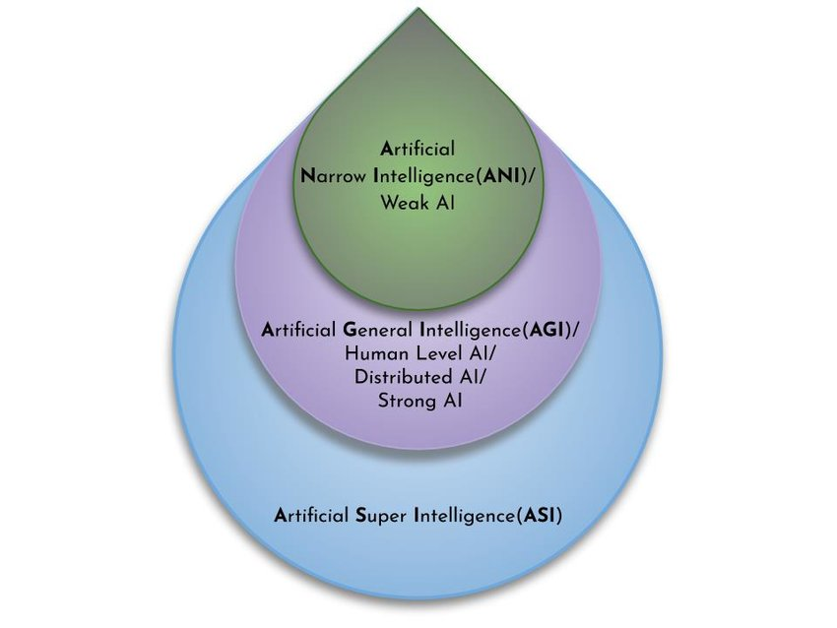
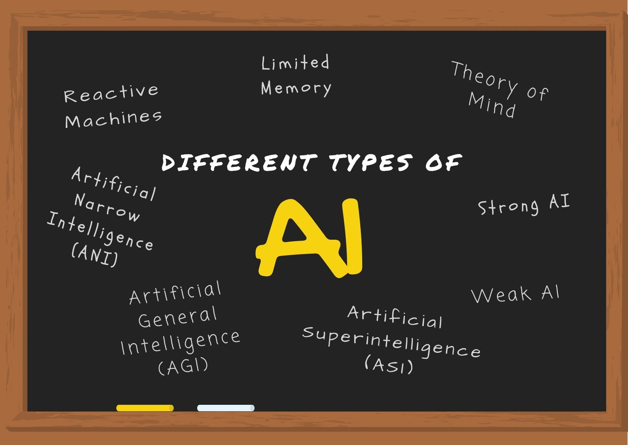

Slide 75
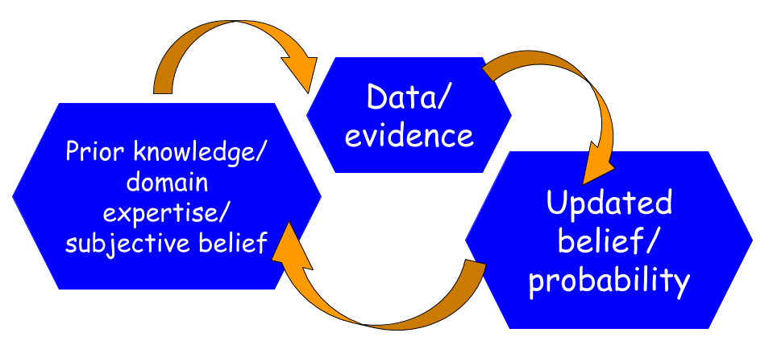
experience or rule-based guideline v. evidence or probability-based data

Slide 76


Slide 77
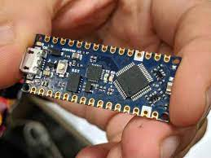
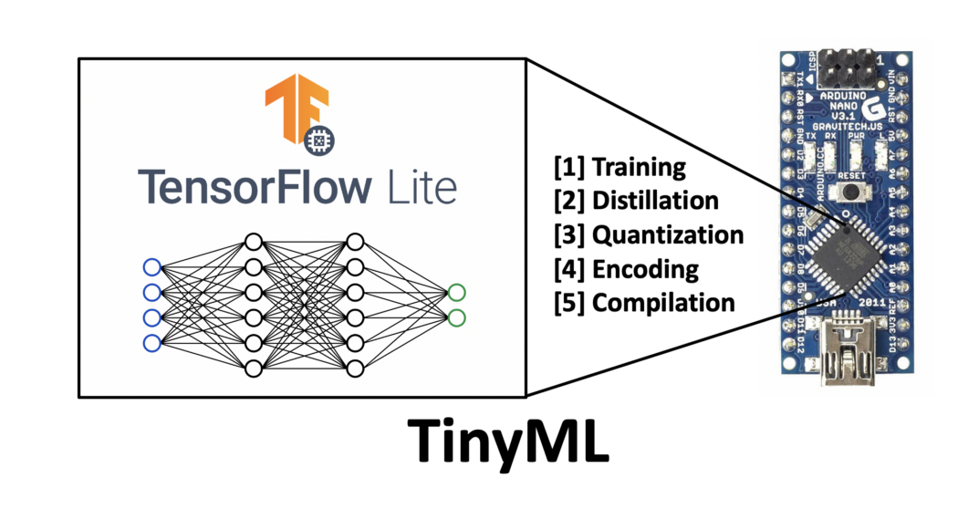
Tiny ML microcontroller

Slide 78


Slide 79
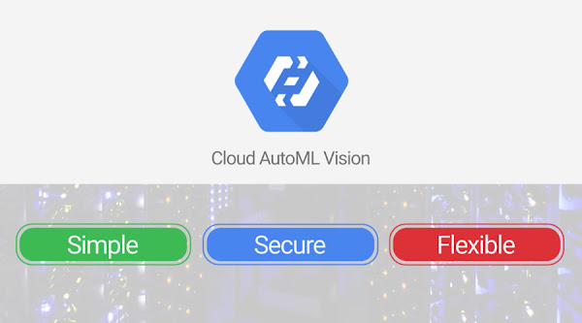

Slide 80
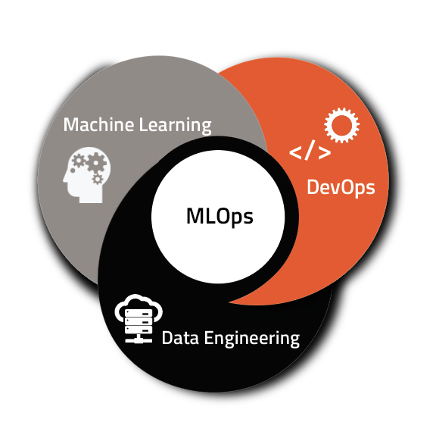

Slide 81
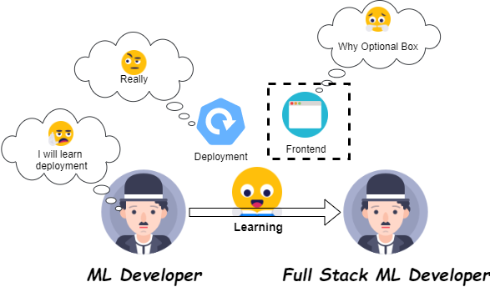
Full stack deep learning

Slide 82
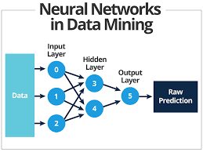
Artificial Neural Network (ANN),
Convolutional Neural Network (CNN), and
Recurrent Neural Network (RNN).

Slide 83
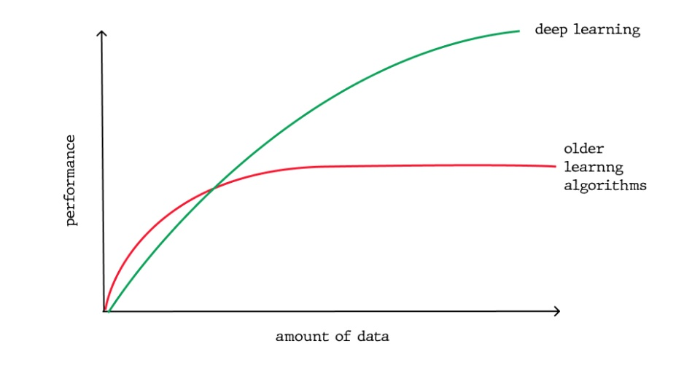
DL Model from:
New unstructured data
Pre-arranged, structured data
From previous experience
Big Data

Slide 84
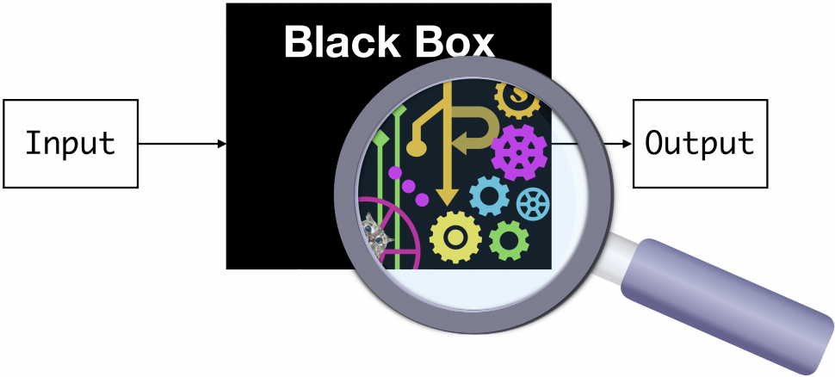
Inherently black box (developers cannot share the details of how the algorithm works in practice)
Deliberately black box (developers know but will not share the details).

Slide 85
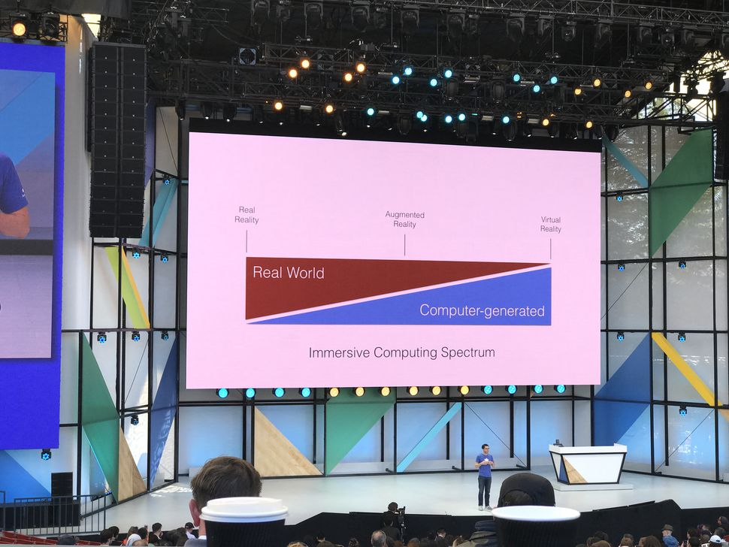
Acronyms
RR, VR, AR, MR, XR:

Slide 86

Real Reality

Slide 87
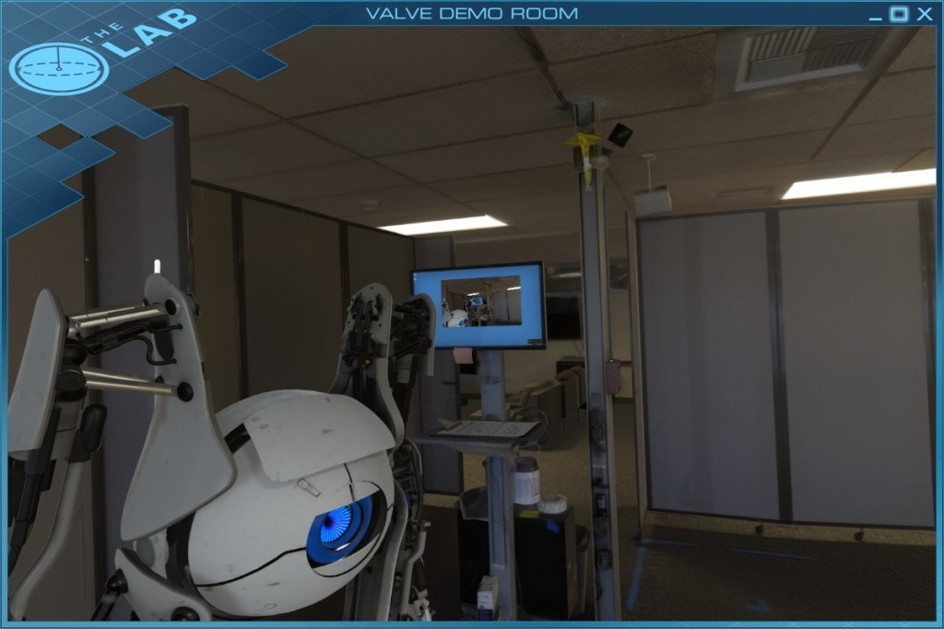

Virtual reality (VR): is technology that shuts the user away from RR, instead replacing every aspect of their reality artificially.

Slide 88

Virtual Reality

Slide 89

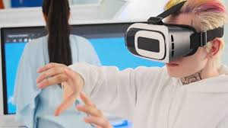
Augmented reality (AR): Supplements real reality (RR) with computer generated imagery of any kind, such as Google Glass, smartphones, Nokia’s City Lens, Pokemon, Go or Snapchat.

Slide 90
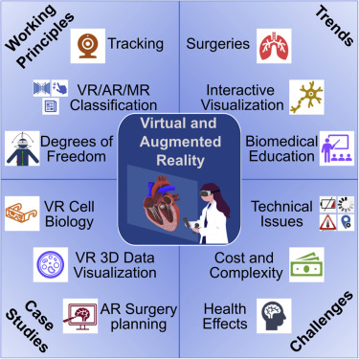

Slide 91
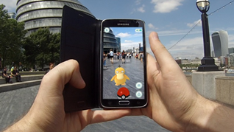

Mixed reality (MR) is similar to AR. It places images and text over the top of RR to create an environment in which the user will treat the objects as if they are really there.

Slide 92


Extended Reality (XR) - all real-and-virtual combined environments and human-machine interactions generated by computer technology and wearables.

Slide 93

The virtual reality (VR) sociable network vTime XR allows users to meet, chat, and share with people around the world a cross-reality (XR) social experience - through augmented reality (AR).

Slide 94


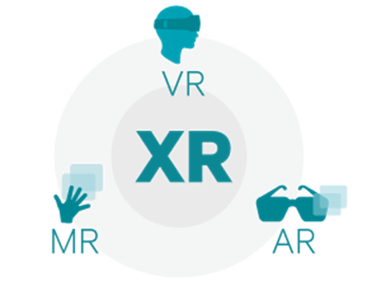

Slide 95


Analytics Insight
Extended Reality Enhancing Healthcare Industry
Extended Reality (XR) Innovation
Modern Healthcare

Slide 96

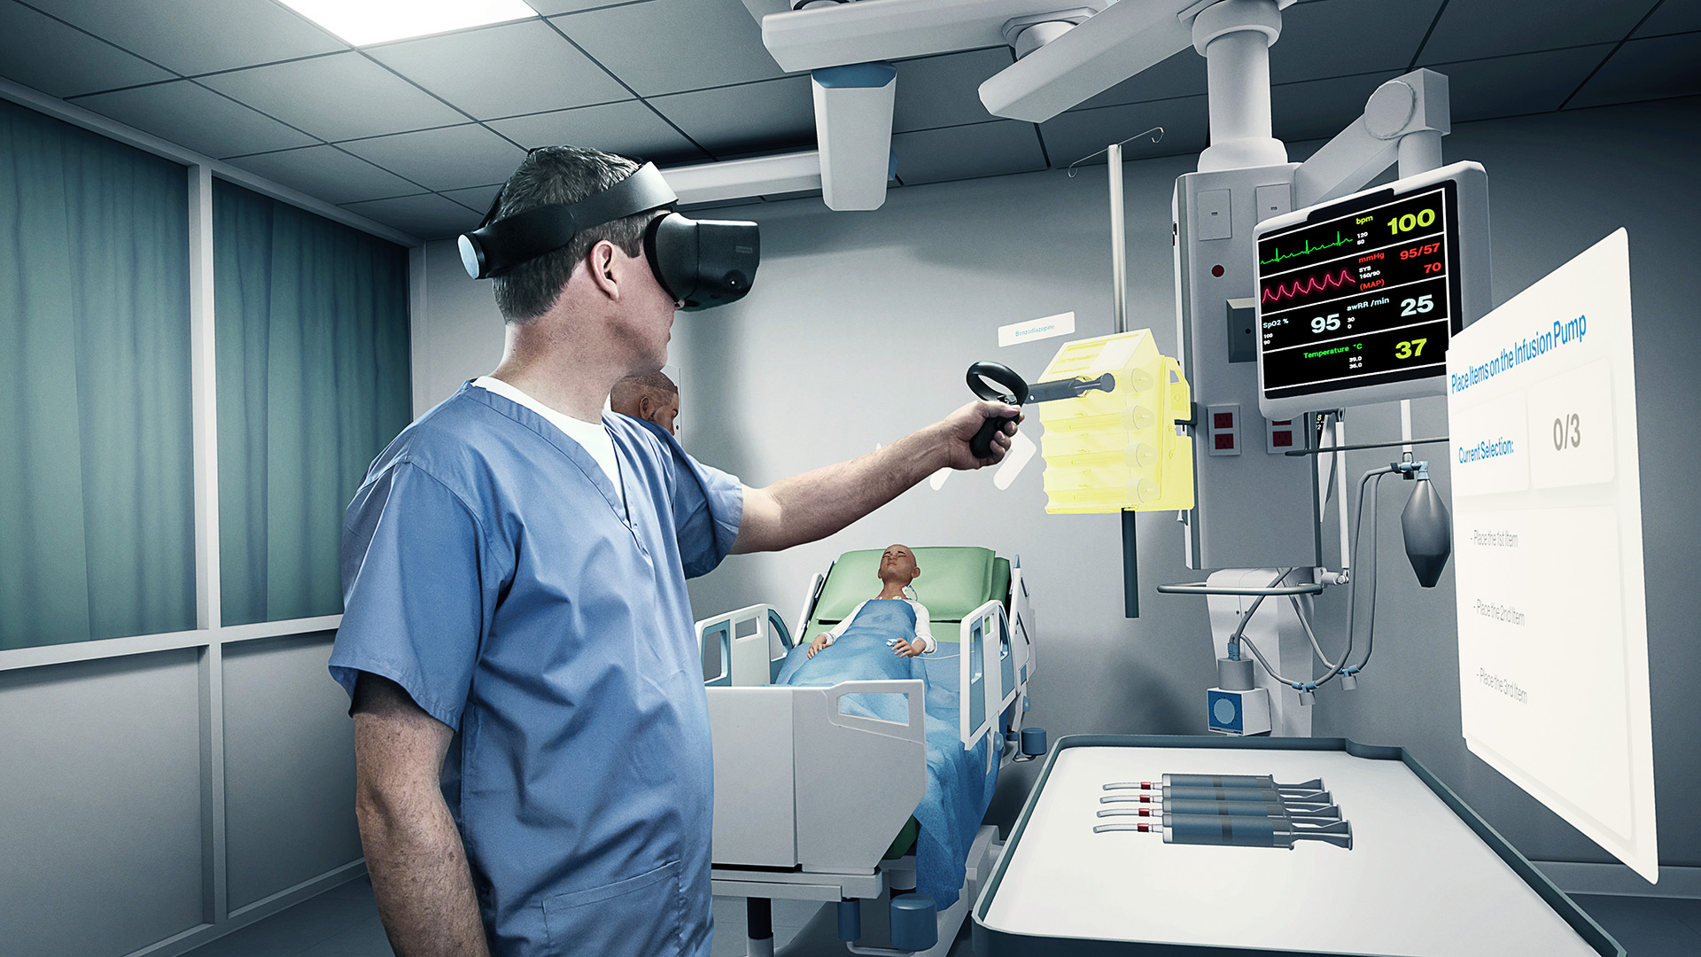
Immersive technology - mixing up virtual content with environment making it a new blended reality with which you are able to engage naturally.
Immersive technologies are transforming the quality and availability of training and communication in medicine..

Slide 97
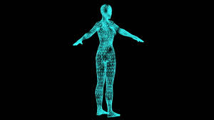

Holograms

Slide 98

MIT Used AI to generate 3D tensor holograms in real-time – no headgear

Slide 99

Combined AR and Hologram

Slide 100


Slide 101
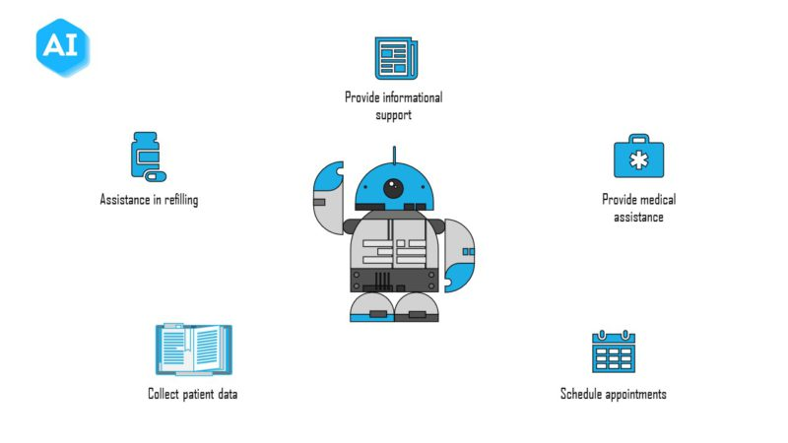

Healthcare chatbots

Slide 102
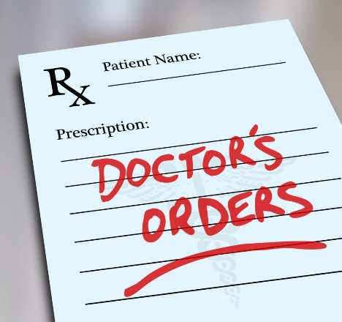
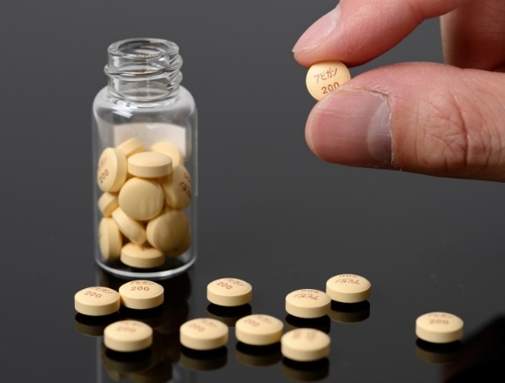


Slide 103
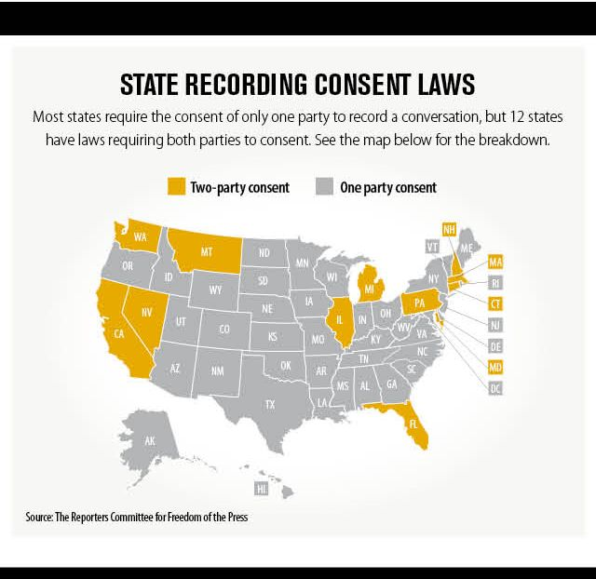


Slide 104

Body-Worn Camera

Slide 105
Ethics of healthcare technology
Concerns about making diagnostic and treatment decisions via the technological advances of AI and Telemedicine;
Doctors and patients prefer the personal touch;
Privacy and liability issues;
Inequity; Better virtual healthcare; Lack of transparency; Skepticism.

Slide 106
Systems Propose Potential Diagnoses
mHhealth apps
Steps followed by a simple app
Convolutional neural network (CNN)
Computer vision
  Object Detection and Image Segmentation
  e.g. Diabetic retinopathy; and Melanoma

Slide 107
Systems Propose Treatment
IBM Watson Health
Reinforcement learning (RL)
Deep RL in sepsis patients - determine dosage of vasopressors and amount of IV fluid to administer.
RL for clinical trial dosing.

Slide 108
Telemedicine (TM)
Children with obesity and diabetes mellitus
Teleglaucoma
Teleotolaryngology (Tele-ENT)
Telehealth and AI Used to Identify Melanoma
Deep Learning, AI Improve Accuracy of Breast Cancer Detection

Slide 109
Telemedicine (TM) and AI
Teleorthopedics – Telerehabilitation (Physiotherapy/function
Telegastroenterology
AI Detects Medication Administration Errors
Artificial Intelligence in Alzheimer’s Disease
Telemedicine in Neuromuscular Care

Slide 110
Telemedicine (TM) and AI
Teleneurosurgery
Telemedicine in Pediatric Infectious Disease
Telemedicine Medical Abortion
AI Analyzes Chest X-Rays in 10 Seconds
Blockchain technology in Telehealth/Telemedicine

Slide 111
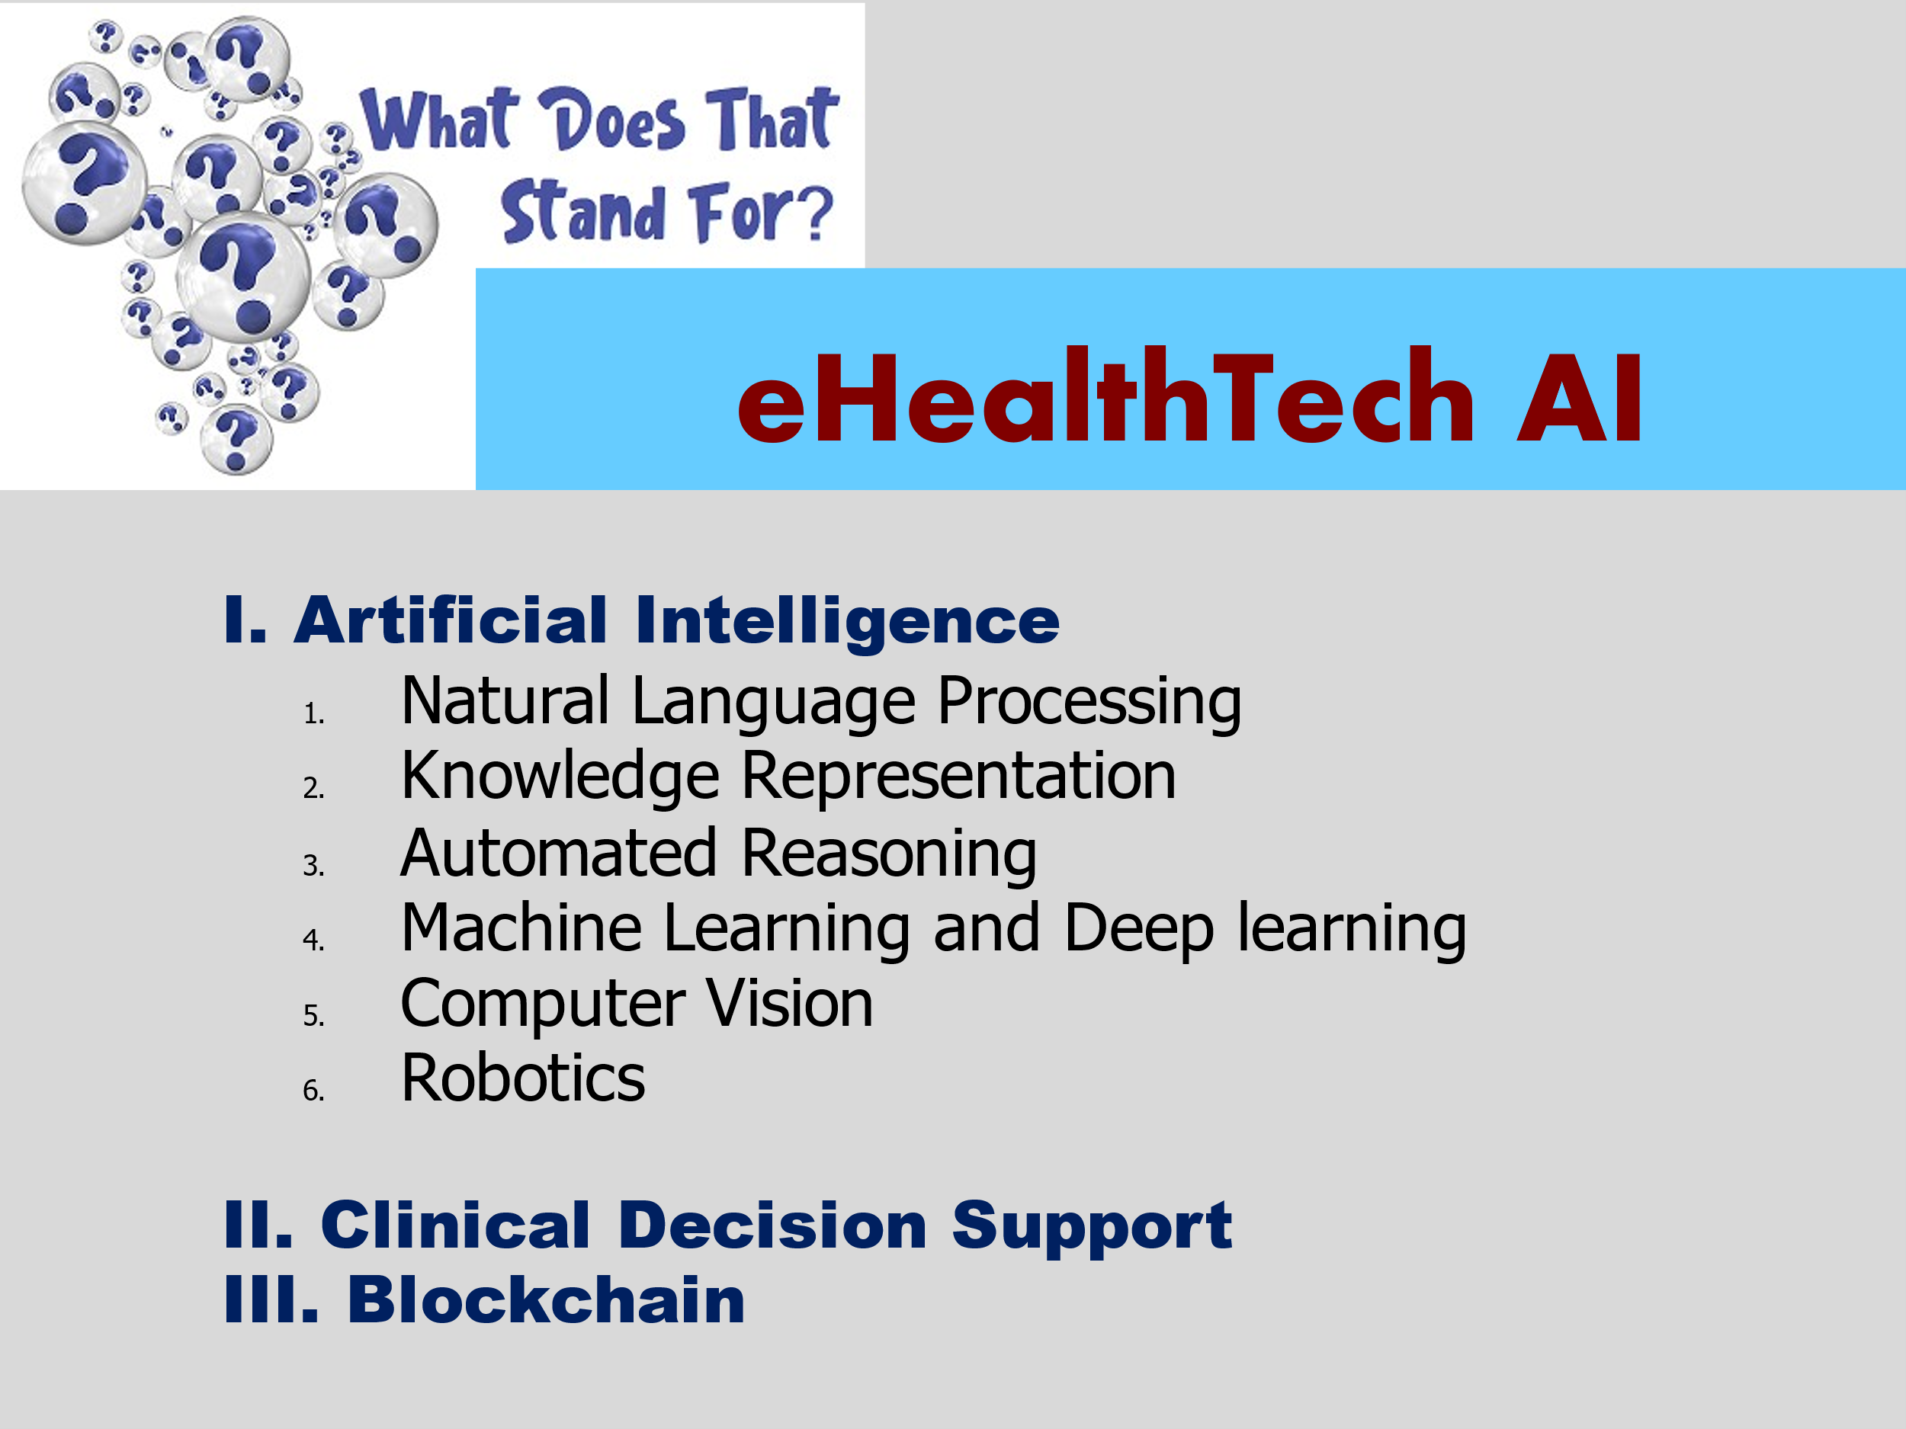
In sum, AI Systems:
Help Dx and Rx;
Help in Developing New Medicines;
Assist in Streamlining Patient Experience
Mine and Manage Medical Data; and
Useful in Robot-Assisted Surgery.

Slide 112
