Slide 1
Professionalism.
Conflict between physician fiduciary duties and the physician contract
Timothy E Paterick MD, JD, MBA

Slide 2
Professionalism
A Huge Societal Duty: the Physician
Fiduciary carries a heavy burden
Professionalism is the basis of medicine’s social
contract with society
This social contract is a fiduciary relationship, setting
and maintaining extraordinary standards of
competence and integrity, and the delivery of
knowledgeable and professional advice to society
on matters of health and well being

Slide 3
Professionalism
The medical profession is being challenged by an eruption
of technology, fluctuating market forces, and problems of the
ever changing health care regulations and laws
The medical profession must contend with political, legal and
market force that challenge physicians to meet their fiduciary
responsibility to their patients

Slide 4
Professionalism
The fundamental principles inherent to physician professionalism:
Patient welfare
Patient autonomy
Elimination of discrimination: race, gender, socioeconomic status, ethnicity or religion
Market forces, societal pressures, and administrative exigencies must not compromise the physician's fiduciary duty

Slide 5
Professionalism
We will discuss:
Necessary physician professional responsibilities
The medical and legal fiduciary obligations (duties) of
physicians
How employed physicians are caught in a web of
ascendant market focus and may be wedged in a
conundrum of how to maintain patient primacy and
their own Professional duties

Slide 6
Professionalism
Professional Responsibilities:
Commitment to professional competence
Integrity
Confidentiality
Appropriate financial personal relations
Access to medical care
Highest quality of medical care
Equitable distribution of resources
Never succumb to conflict of interests for personal financial gain

Slide 7
Professionalism
Informed Consent
Best Rxment available with shared decision making
Limits liability
Medical ethic, common law, and codified statutory
law mandate informed consent
Paterick et al Informed Consent: General Considerations for
Physicians Mayo Clinic Proceedings 2008 Mar 83(3): 313-19
The objective of medical care must be availability of
uniform, excellent standards of care across all demographics
and socioeconomic classes

Slide 8
Professionalism
Physicians must diligently access the just distribution of finite
medical resources by providing health care that is based upon
judicious and cost effective management of limited resources
and financial healthcare dollar deficits
Conscientious avoidance of tests and procedures that are
unnecessary and financially driven
Unwarranted medical services expose patients to risk and
expense and limits the resources available to those in true need
Physicians must disclose conflicts of interest
Physicians have a moral and ethical duty to report unethical
behavior of physicians or organizations

Slide 9
Professionalism
Fiduciary Responsibilities of Physicians
“Fiduciary” = “Trust”
The covenant of trust between the patient and the physician is vital to the diagnostic and therapeutic process
Medical paternalism transitioned to patient autonomy where it was determined that patients had the right to make their own decisions and now has transitioned to shared decision making

Slide 10
Professionalism
The Law:
In 1914, in Schloendorff v Society of New York Hospital, Justice Cardozo wrote: “Every human being of adult years and sound mind has a right to determine what shall be done with his own body, and a surgeon who performs an operation without his patient’s consent commits an assault”

Slide 11
Professionalism
The Law:
Canterbury v Spence the court ruled a physician has a
duty to disclose to a patient the material risks associated with
a proposed therapy that a reasonable patient would need to
hear to make an informed decision.
Paternal to autonomy to shared decision making – this is a
two way exchange that represents the true patient – physician
relationship.

Slide 12
Professionalism
The Law
Informed consent is a physician’s DUTY to the patient
medically, ethically, morally and legally
Salgo v Leland Stanford Jr. University Board of Trustees, where a
California Court of Appeals declared that:
“a physician violates his duty to his patient and subjects herself
to liability if she withholds any facts which are necessary to
form the basis of an intelligent consent by the patient to the
proposed treatment.”
Subsequent to this decision informed consent became an
ethical and legal duty imposed upon physicians

Slide 13
Professionalism
In a world exploding with medical information and
disinformation through television advertising, Internet, and multiple social media platforms, physicians must know to respond to informed and misinformed patients.
Physician often encounter requests for medical care that is not medically necessary by patients who have misinterpreted information or have received misinformation on the Internet or TV advertising
Physicians must remember their fiduciary responsibility even at the chance of losing revenue
The law empowers physicians to say no to services that are not necessary
This may lead to the loss of a patient but is a fiduciary responsibility

Slide 14
Professionalism
The Threats to Physician Professionalism
Numerous provisions in physicians’ contracts interfere with physician fiduciary duties
In the new era of employed physicians, problematic contractual clauses impede physician’s professional fiduciary responsibilities.

Slide 15
Professionalism
The Threats to Physician Professionalism
Confidentiality clauses
Incentive clauses
Referral restrictions
Gag Clauses
Termination without cause

Slide 16
Professionalism
What to be aware of when you are signing a contract

Slide 17
Professionalism
Confidentiality clauses
Often attempt to hide quality and safety
issues, medical errors, unethical
conduct and malfeasance
The confidentiality clauses can prevent physicians from
meeting their fiduciary duties: reduce medical errors,
patient safety, prevent misuse of medical resources

Slide 18
Professionalism
Incentive clauses
Most physician contracts include productivity incentives;
physicians have been terminated for low productivity
Induce activities that increase employer income and
inspire over testing/treatment
Physicians must provide healthcare that is based upon
judicious and cost-effective management of limited
clinical resources

Slide 19
Professionalism
Referral Restrictions
“Leakage control”
Many organizations have physician navigators who direct patients
to specialists within the health system and take away control of
the referral
Contractual clauses interfering with referral to skilled physicians
directly opposes the fiduciary

Slide 20
Professionalism
Gag Clauses
Prohibit physicians from revealing quality and safety problems,
medical errors, and unethical conduct
Gag Clauses & Clauses terminating without cause are in direct
opposition to physicians fiduciary duties

Slide 21
Professionalism
The Conundrum Physicians Face
Physicians are juxtaposed between fiduciary duties
and contractual obligations
This juxtaposition results from corporate medicine
letting the demands of the marketplace undermine
the professional goals and fiduciary duties of
physicians

Slide 22
Professionalism
It is a daunting
time for physicians, patients and society
This may require physicians to organize
collectively to bargain with uncompromising
and unyielding employers

Slide 23
Physician Fiduciary
Understanding Trusteeship
Physicians, acting as fiduciaries and trustees to patients, have a
doctor – patient relationship.
This relationship will lead to high quality medical care,
excellent health outcomes, and contained medical costs.
Physicians must understand the importance of being a
fiduciary and trustee to their patients in a complex healthcare
arena that has changes from palpable public responsibilities
to a profit maximizing business model.

Slide 24
Professionalism
What is a common good?
It consists of communal values, about what we owe one another as citizens,
Bound together in the same society seeking the rules and principles we seek
to achieve together
A concern for a moral good is an ethical attitude that recognizes we are all
in it together. If there is no common good, there is no society.
The original intent of the health insurance plan was to share the risk of illness
across all demographics and to cover as many people as possible ie
MAXIMIXZE THE COMMON GOOD

Slide 25
Professionalism
The nonprofit BCBS accepted everyone who wanted to be a
member. Every member paid the same rate, irrespective of
age or health … in the 1960s BCBS was providing coverage to
5o million Americans
1970s … for profit insurance companies like Cigna and Aetna –
Accepted only younger and healthy patients … lower premiums
1994 BCBS could not compete so transitioned to for-profit
Everyone was insuring the healthy and avoiding the sick
Death of the Common Good

Slide 26
Professionalism
Physicians have a duty to meet with administrators to
discuss how to restore -- The common good in health care
This is not just about ethics … it is about restoring the
common good and trust in our health care system
Presently the healthcare systems in America are
not trusted by society
We as physicians must restore that trust

Slide 27
Professionalism.
Conflict between physician fiduciary duties and physician contract
Timothy E Paterick MD, JD, MBA

Slide 28
Professionalism
During this lecture we have traveled a long distance
across many complex topics
We must accept the challenge of restoring
the COMMON GOOD as it impacts all
of us in the present day society
It is the essence of PROFESSIONALISM

Slide 29
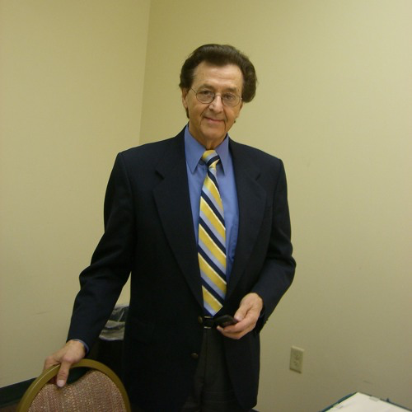
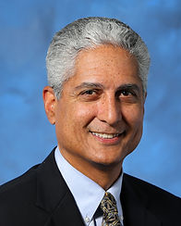
Professionalism
Pictorially

